Slide 1

ORNL Visual Analytics Research & the ORNL VISTA Center
Chad A. Steed
Senior Research Staff & VISTA Lab Director
Computer Science and Mathematics Division
steedca@ornl.gov | http://csteed.com

Slide 2
Talk Overview
ORNL Overview
ORNL Visual Analytics R&D Overview
Deep Dive on Additive Manufacturing Visual Analytics Project
Highlights of other Visual Analytics Projects
The ORNL VISTA Center
Career Opportunities at ORNL
Conclusion

Slide 3
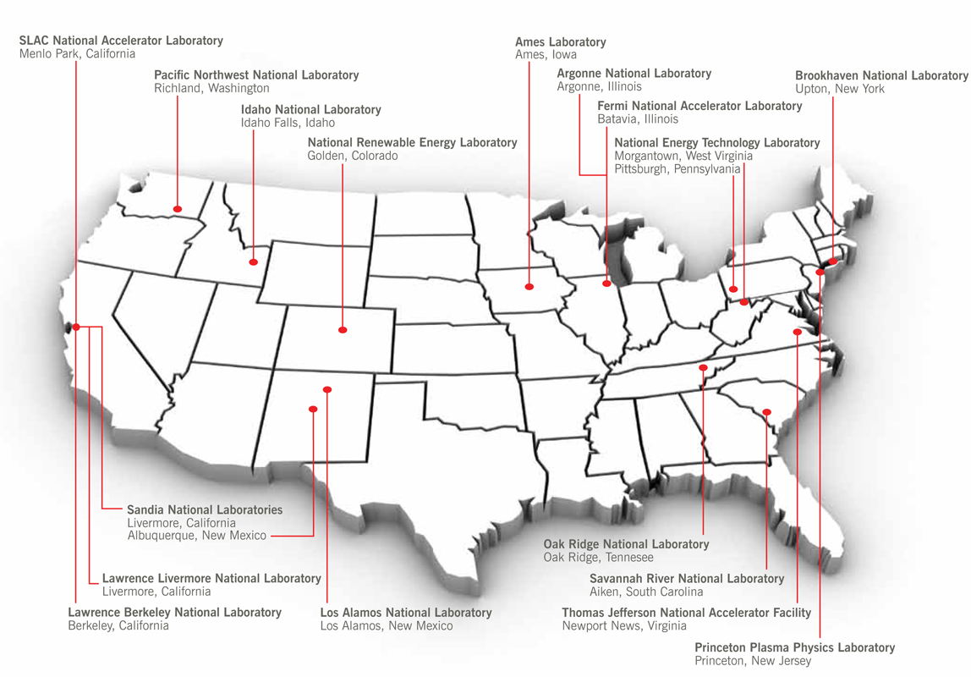

A Little About ORNL…

Slide 4
DOE National Laboratories As stated in the DOE Strategic Plan*, National Laboratories . . .
Solve important problems in fundamental science, energy, and national security.
Steward vital scientific and engineering capabilities including technology transfer that are essential to our nation’s continued science and technology primacy in a rapidly changing world.
Design, build, and operate unique scientific instrumentation and facilities that serve tens of thousands of scientists and engineers from academia, government, and industry collaborating on solutions to pressing and complex problems.
Promote innovation that advances U.S. economic competitiveness and contributes to our future prosperity.
*http://energy.gov/sites/prod/files/2014/04/f14/2014_dept_energy_strategic_plan.pdf
Notes:
National laboratories solve important problems in fundamental science, energy, and national security.
They collaborate with academia, other government agencies, and industry to develop and deploy scientific and technological solutions in support of national needs. Specifically, the laboratories:
• Conduct world-leading research in the physical, chemical, nuclear, biological, and information sciences that advances our understanding of the world around us;
• Advance U.S. energy security and leadership in clean energy technologies to ensure that energy is abundant, clean, affordable, and reliable; and
• Enhance our national security by ensuring the safety and effectiveness of our nuclear deterrent, helping prevent the proliferation of weapons of mass destruction, and securing our borders.
National laboratories steward vital scientific and engineering capabilities including technology transfer that are essential to our nation’s continued science and technology primacy in a rapidly changing world.
These capabilities are used primarily to address long-term national problems, but also can be tapped to respond to technological surprises and nearer term challenges, as evidenced by the labs’ responses to the Gulf oil spill and 9/11. The core of the national laboratories is a first-rate workforce of research scientists, engineers, and support personnel that is entrusted to serve the American people.
National laboratories design, build, and operate unique scientific instrumentation and facilities that serve tens of thousands of scientists and engineers from academia, government, and industry collaborating on solutions to pressing and complex problems.
These facilities, which are found nowhere else in the world, support open scientific research as well as classified work. They continually advance the state of the art through the development and use of next-generation tools and technologies. They enable fundamental scientific discoveries, ensure our national security, and assist industry (with new materials, improved manufacturing processes, and advanced product testing).
National laboratories promote innovation that advances U.S. economic competitiveness and contributes to our future prosperity.
They partner with others, especially industry, to integrate fundamental and applied research to the broad benefit of the economy. They contribute materially to U.S. economic prosperity by making key scientific discoveries, demonstrating the utility of these discoveries in early prototypes, and working with industry to move these technologies into the marketplace, thus creating high-paying jobs. The laboratories’ prowess is evidenced by their disproportionately large number of R&D 100 Awards and proven track record in technology transfer and commercialization.

Slide 5
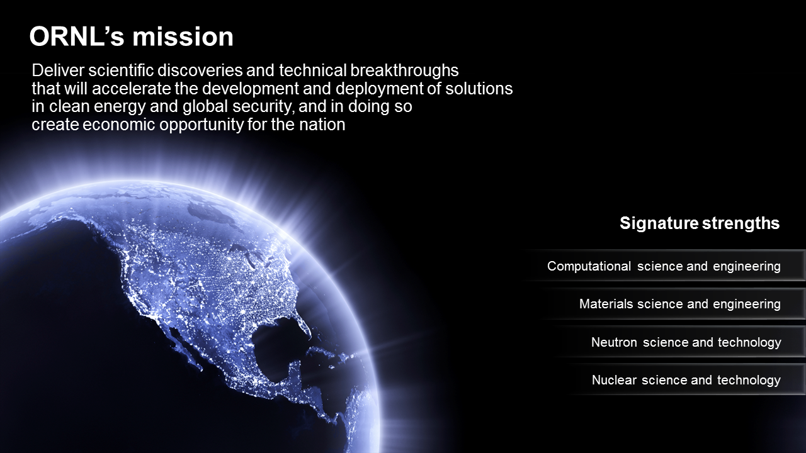
Notes:
This document has been reviewed and is determined to be
APPROVED FOR PUBLIC RELEASE.
Name/Title: Leesa Laymance / ORNL TIO
Date: 4/26/2017

Slide 6





CCSD vision Sustain leadership and scientific impact in computing and computational sciences
Provide world’s most powerful open resources for scalable computing and simulation, data and analytics, and infrastructure for science
Follow a well-defined path for maintaining world leadership in these critical areas
Attract the brightest talent and partnerships from all over the world
Deliver leading-edge science relevant to missions of DOE and key federal and state agencies
Invest in cross-cutting partnerships with industry
Provide unique opportunity for innovation based on multiagency collaboration
Invest in education and training
Notes:
6

Slide 7
Structure for the DOE/ASCR Research Program at ORNL
Scalable Computing Infrastructure for the DOE Mission
Goal
Accelerated Node Computing
Federated Instruments and Facilities for Science
Integrated Research Areas
DOE Applications
(Integrated) Simulation- and Data-science Methods
ORNL Capabilities
Experimental Computing Technologies
Programming Systems
Workflow Systems
System Science

Slide 8
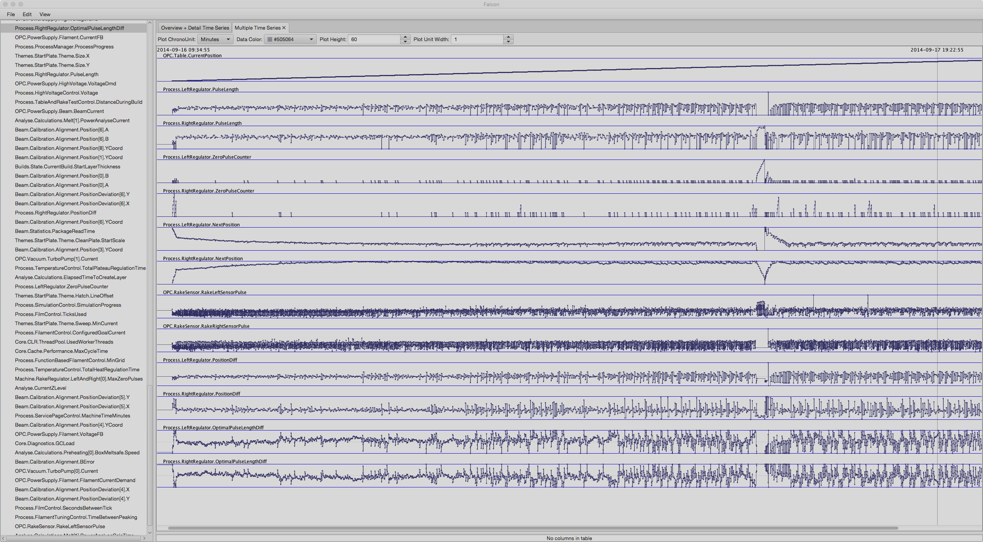
DATA
Insight
Notes:
Today’s data offers unprecedented potential to transform nearly all facets of our society, from scientific challenges to social issues.
However, the volume and complexity of data is increasing at a rate that exceeds our ability to make sense of it. – the difference in rates means missed opportunities.
To transform data to actionable insight, new data science tools must be brought to bear.
Interactive data visualization is an integral part of data science, as it empowers the user to explore data and stresses a penetrating look at its structure.
At the top of this slide, is a sliver of a log file, which represents the messy and semi-structured format common of today’s data.
In this form, the human mind cannot make sense of it.
However, when transform it into a time series graph and study several different sensor readings, patterns and associations are easily recognized.
This attests to the power of interactive data visualization to make the invisible insight visible

Slide 9
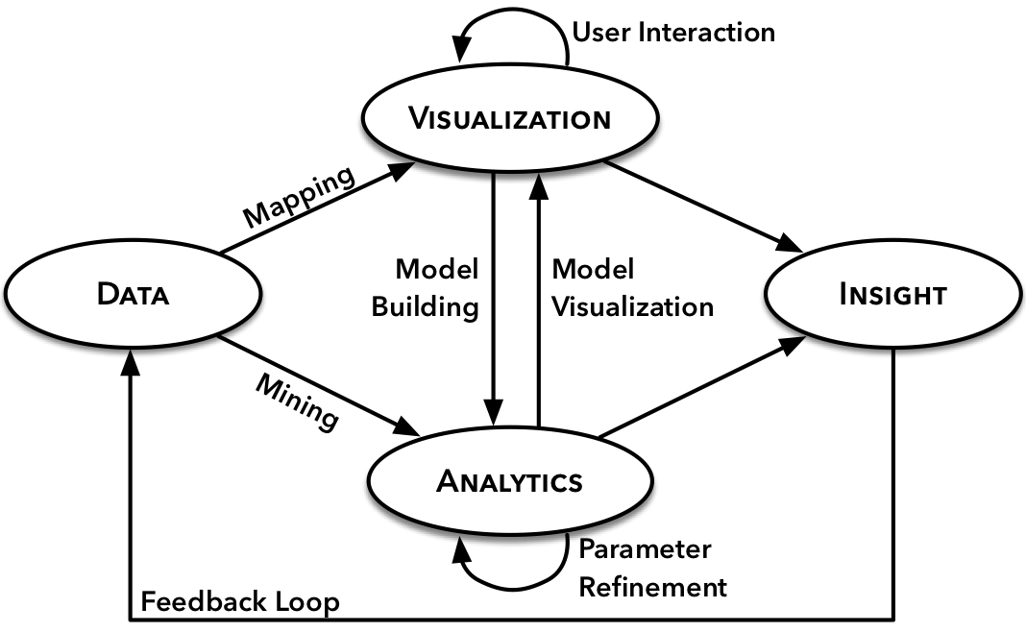
Visual Analytics: Uniting Humans and Computational Strengths

Slide 10

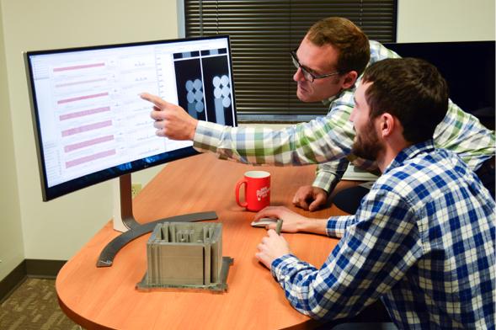
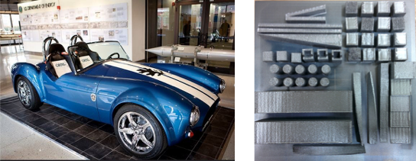
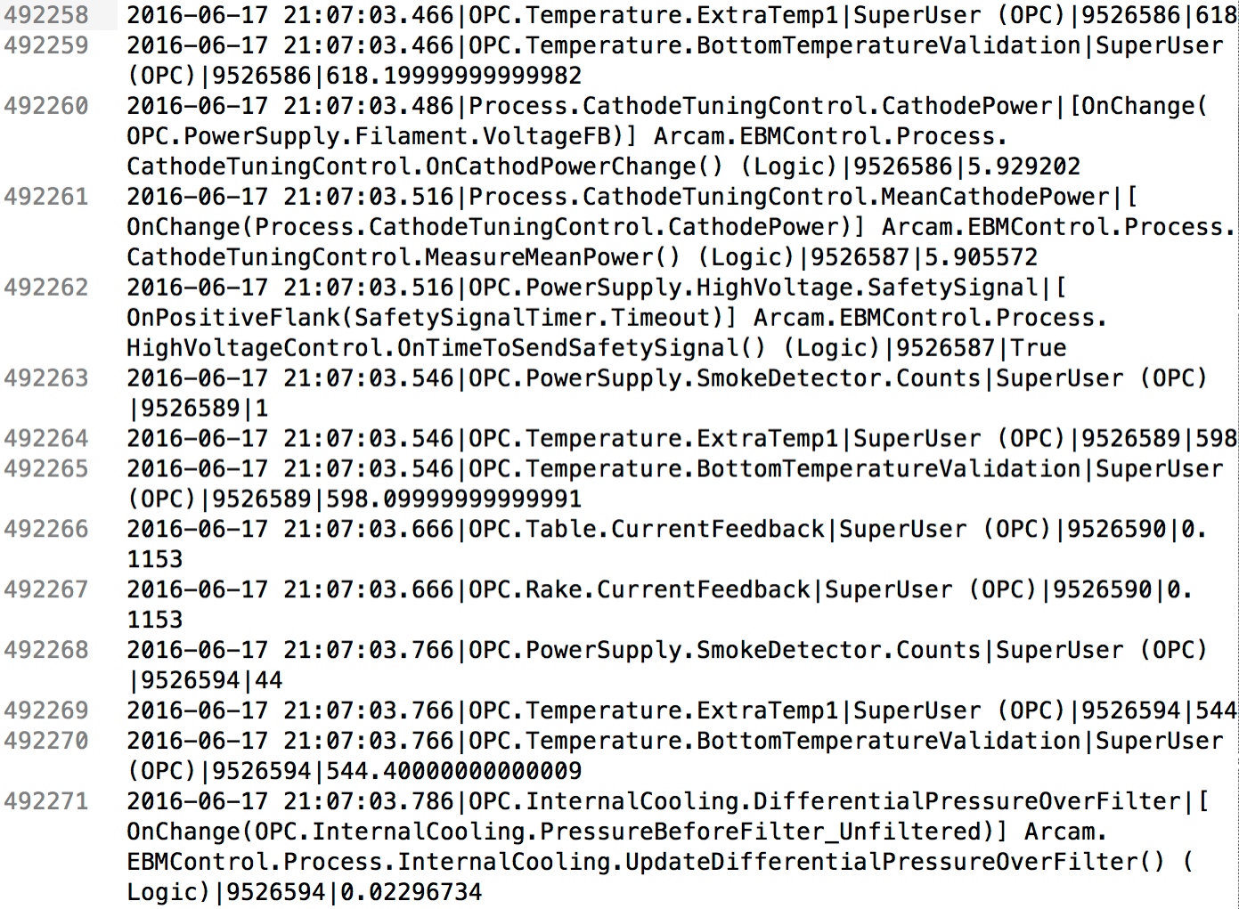
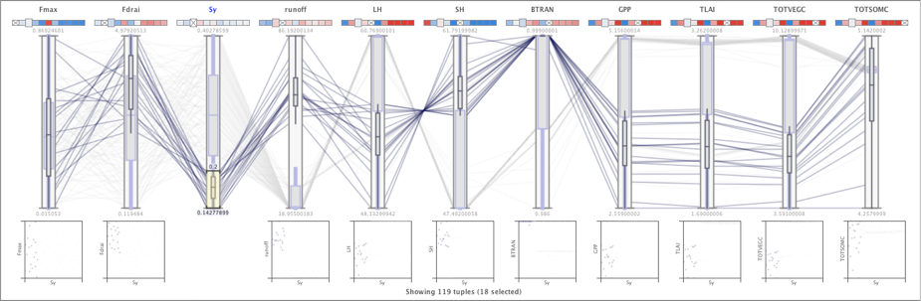
A Typical ORNL Data Visualization Project
Domain Experts
Dr. Ryan Dehoff
Additive Manufacturing
Scientific Domains
Large-scale 3D Printing
Real-world Data
Large, Complex, Unique
Results / Artifacts
Tools, Techniques,
Publications, Patents,
Open Source Software
Notes:
In my work, I seek to develop strong interdisciplinary partnerships with domain experts.
I’ve worked with experts in climate, cyber security, energy, materials science, national security, and manufacturing, to name a few.
Even my more fundamental research projects incorporate some form of illustration in a real-world scenario.
The are several reasons why.
It comes with the territory of working at a national lab where I’m surrounded with use cases.
I enjoy bridging the gap between data visualization theory and practical applications.
It can be a form of validation of the techniques, showing how these new techniques enable new discoveries in challenging domains.
This mode of operation requires a collaborative spirit, networking skills, and agility (or the ability to quickly learn new domains).
In this slide, I show the life cycle of a typical project.
GO THROUGH STAGES

Slide 11
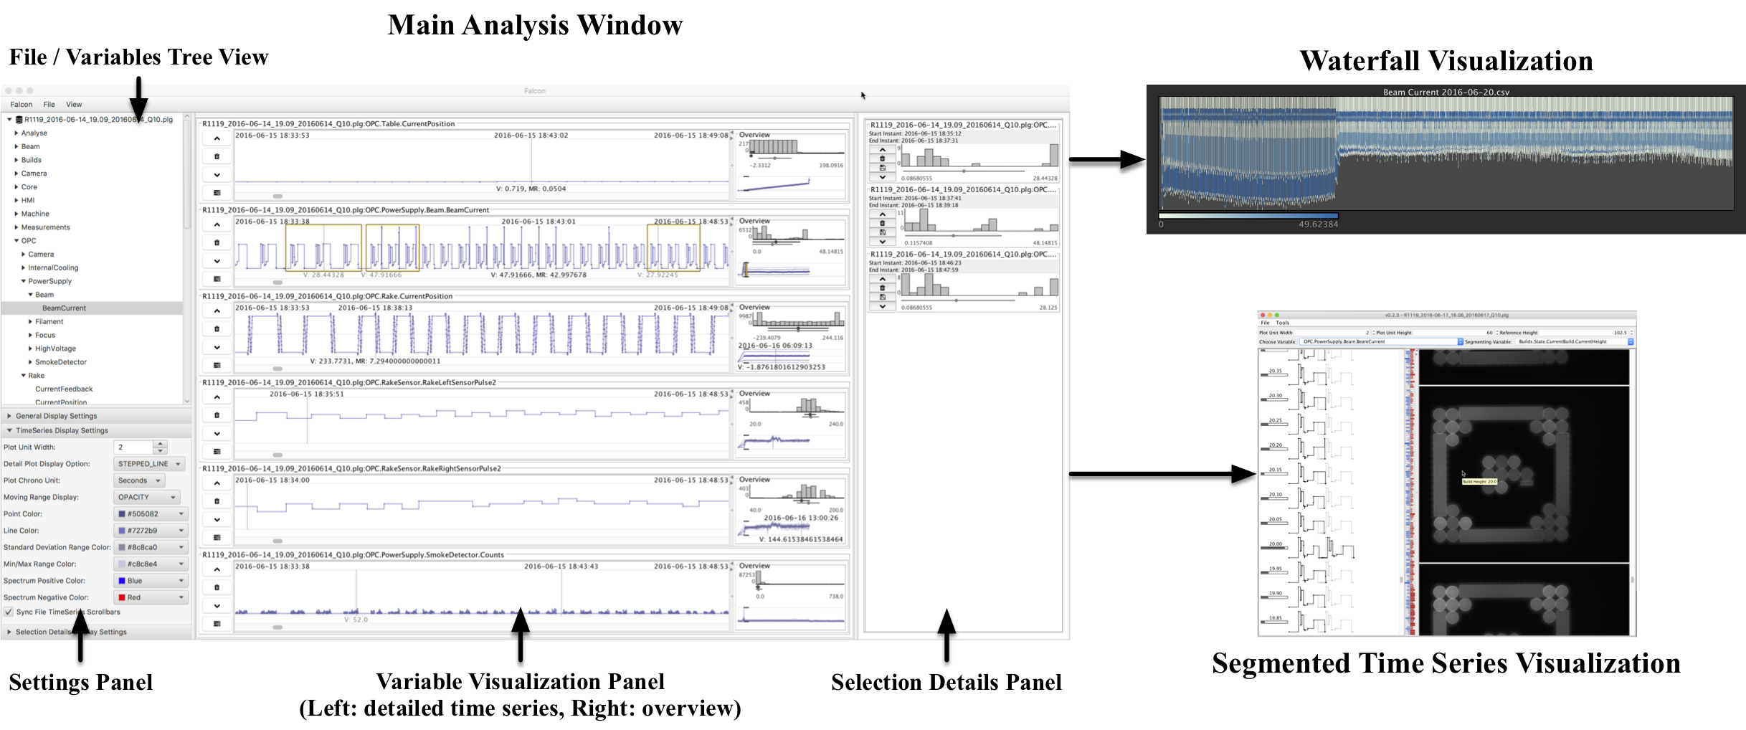
Introducing Falcon

Slide 12
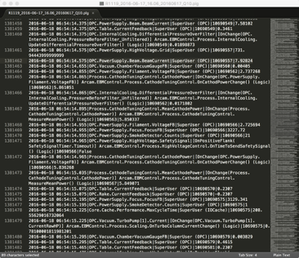

Data Transformation and Modeling
Log files are read into time-based bins at variable levels of detail
Support drill down / roll up between overviews and detailed visualizations
Statistical summaries derived from raw data
Only read variable data into memory if requested
CSV import or custom reader available

Slide 13
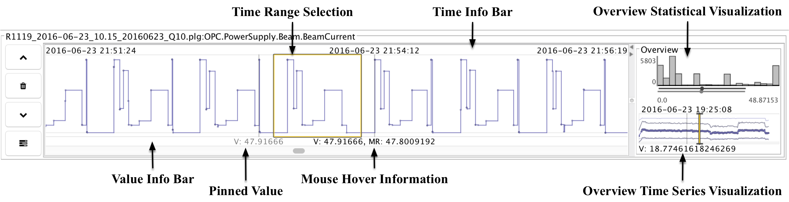
Variable Visualization Panel
Consists of 1 detail visualizations and 2 overviews for a particular variable of interest (stacked for multiple variables)
Interactions within each view are linked
Details-on-demand capabilities

Slide 14
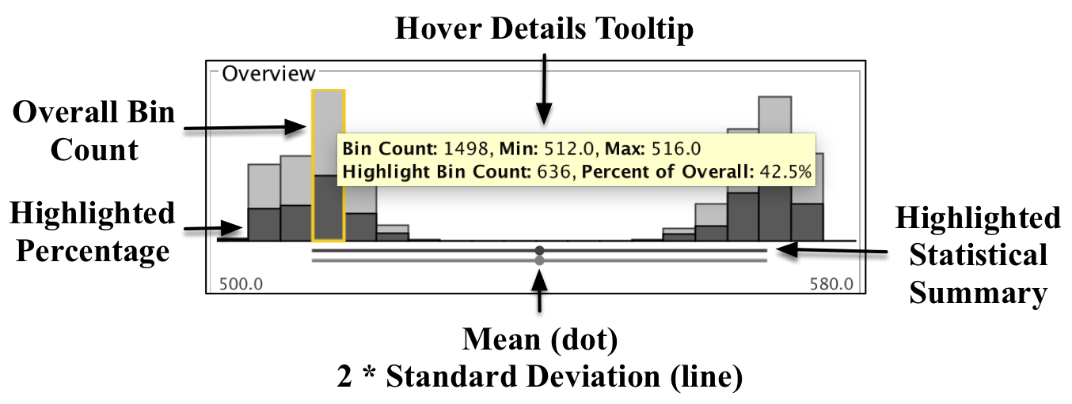
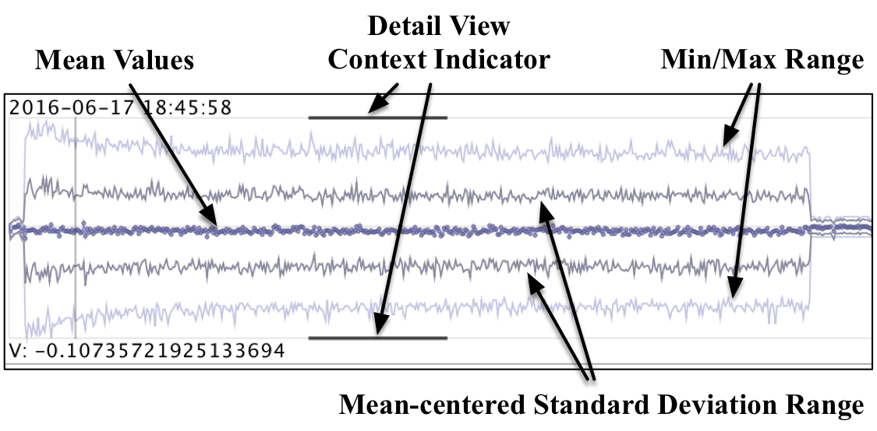
Overview Variable Visualizations

Slide 15
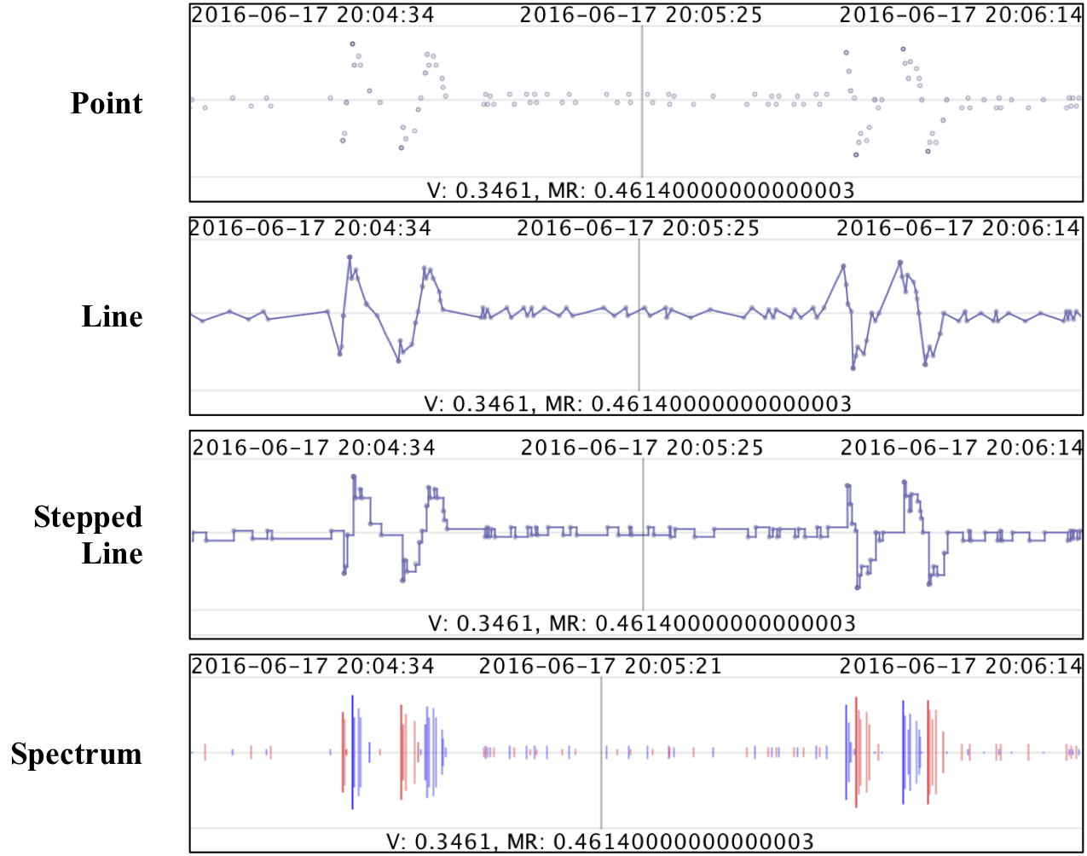
Detailed Time Series Visualization Modes

Slide 16
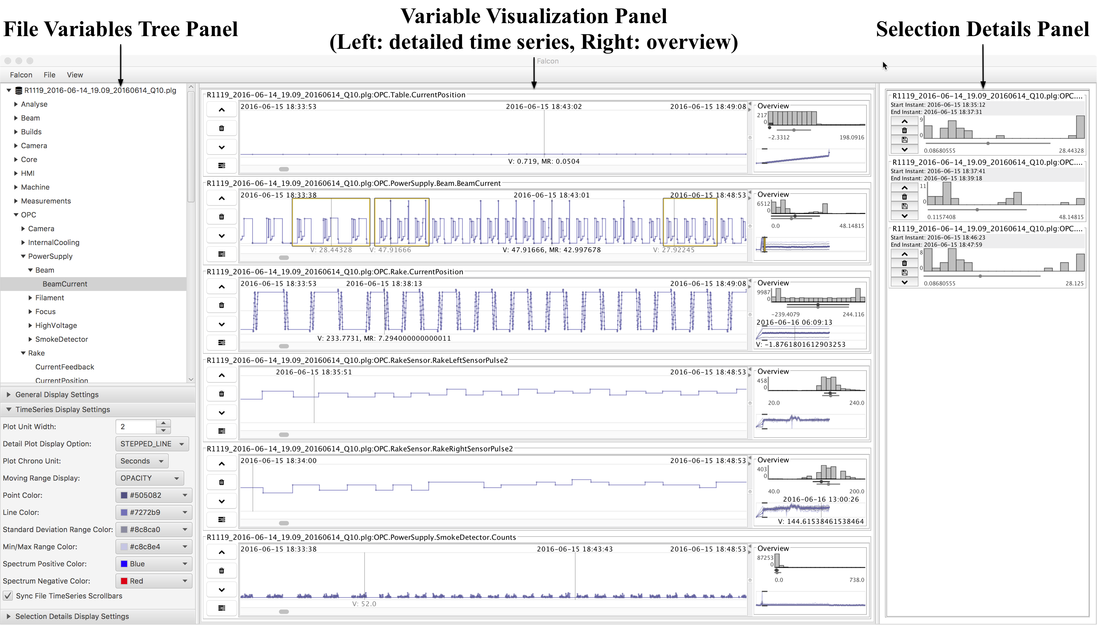
Selection Details Visualization Panel

Slide 17
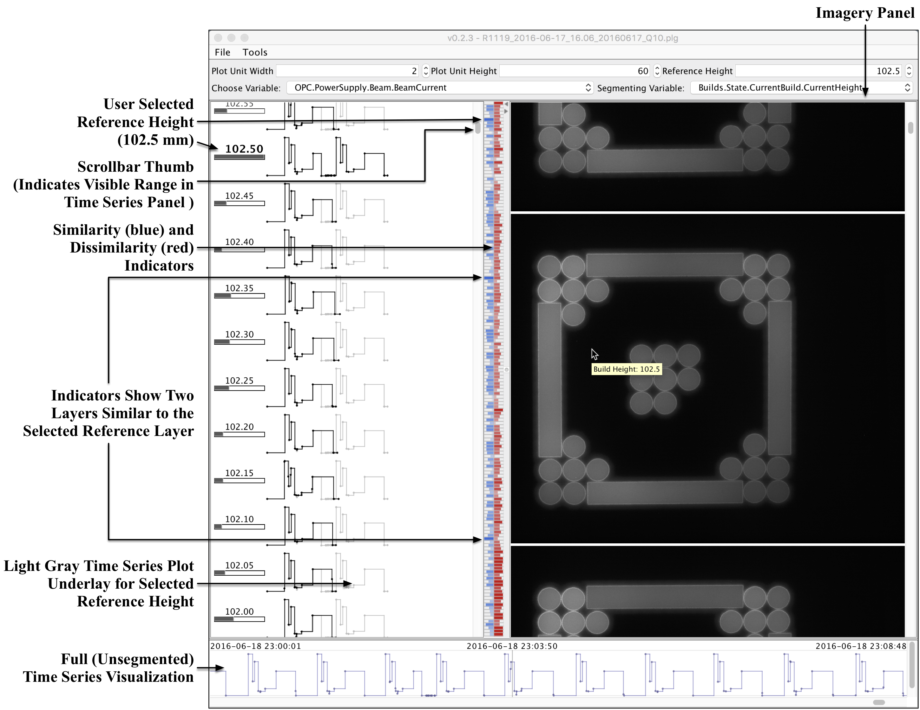
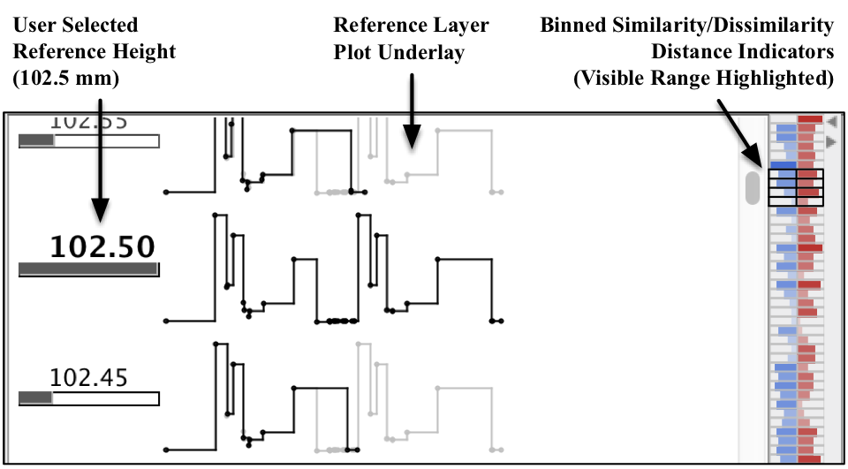
Segmented Time Series Visualization (Layers + Imagery)
Closeup of Similarity Metrics

Slide 18
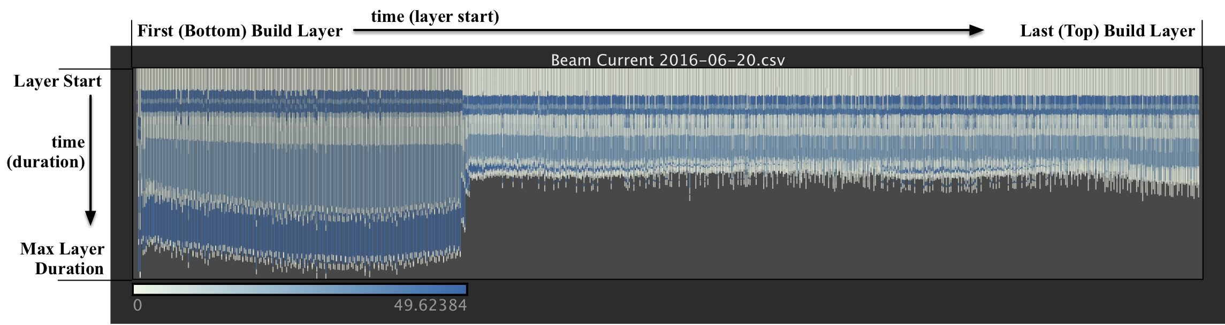
Concise Segmented Visualization (DNA Plot of a 3D Print)

Slide 19
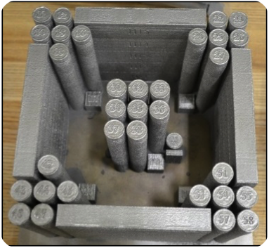
Case Study: Analysis of 3D Printer Build
Arcam Q10 3D Printer System
Uses electron beam melting to synthesize metallic objects
Data from the build of a special test configuration used to ensure the Q10 system is functioning properly
Four distinct geometrical layouts and 5 specific features
Created entirely from the build platform without support structures

Slide 20
General Analysis Strategy Using Falcon
Overview First
Researchers naturally gravitated toward a workflow that parallels Shneiderman’s visual information seeking strategy*
Being with overview of key variables
Drill down to explore patterns
Note interesting patterns and trends along the way
Combine log and imagery data for big picture
Follow-up with physical investigations to validate findings (e.g., scanning microscopy)
Zoom and Filter
Details on Demand
* B. Shneiderman. “The eyes have it: A task by data type taxonomy for information visualizations.” In Proceedings of the IEEE Symposium on Visual Languages, pp. 336–343, 1996.

Slide 21
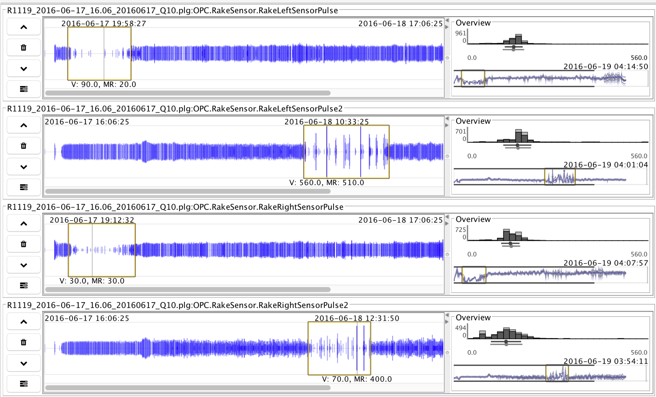
Overview First
Notes:
Use spectrum time series plot mode to study four rake sensors over the entire build.
Normal build should show minimal variation w/o large gaps
Here the gaps and spikes may indicate problems with the powder bed consistency or rake blade which warrant further investigation
Spectrum plots excels at revealing such conditions

Slide 22
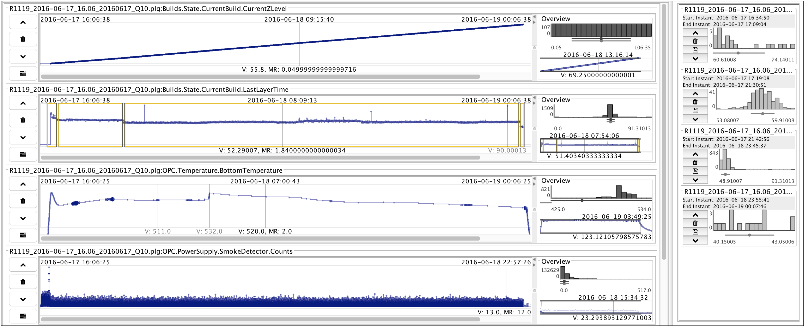
Overview First
Notes:
A set of key variables are always explored as an overview by manipulating the time scales of the details plot.
Key variables based on experience with using the tool
Many other variables are also considered in a normal session but we focus on a handful here
Here we have about a 2-min. resolution and four key variables
Z level is normal (ht. in mm from bottom layer)
Eye is drawn to bottom temp plot where abnormal pattern is detected; warrants additional investigation as it may indicated a change in processing params due to geometry of the object
Last layer time, related to last layer’s melt area.
Four distinct stages are selected
Third selection range holds three outlier layers. Skew histogram plots.
Suggest something bad occurred in preceding layer; warrant more study

Slide 23
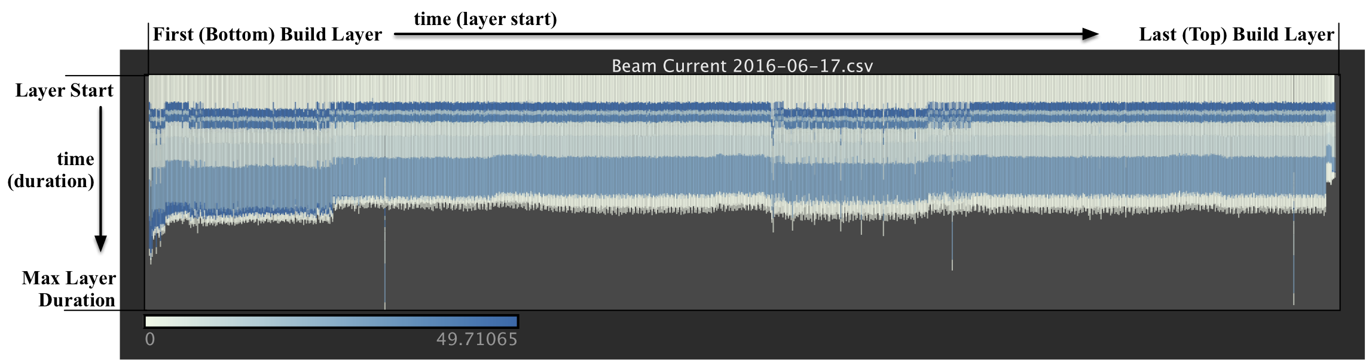
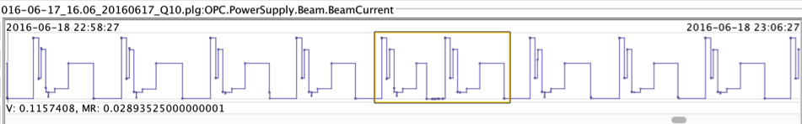
Overview for Particular Variable (Electron Beam Current)
Notes:
Focused view on beam current
4 distinct geometry regions are seen again
three outliers are easily spotted
Also more subtle variations are seen that may be overlooked in the first view.
Slight variances in the preheat stages of each layer
Smaller variations in layer duration in the middle of the build.
Those variations would warrant additional study but we will focus on the more drastic anomalies here for the sake of brevity

Slide 24
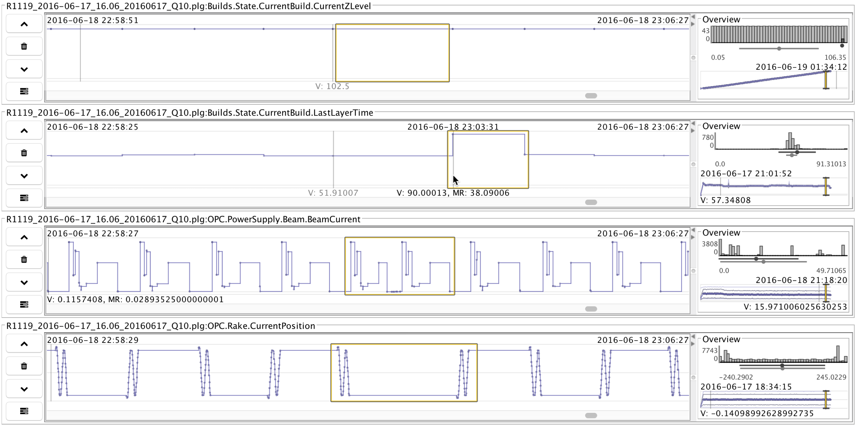
Zoom and Filter
Notes:
Zoom into the detail time series by changing the time scale settings to investigate one of the outlier layer times
We see signals of the increased layer time.
Repeat pattern in beam current visualization
Caused by an arc trip, that may indicate problems in the microstructure of the printed objects

Slide 25
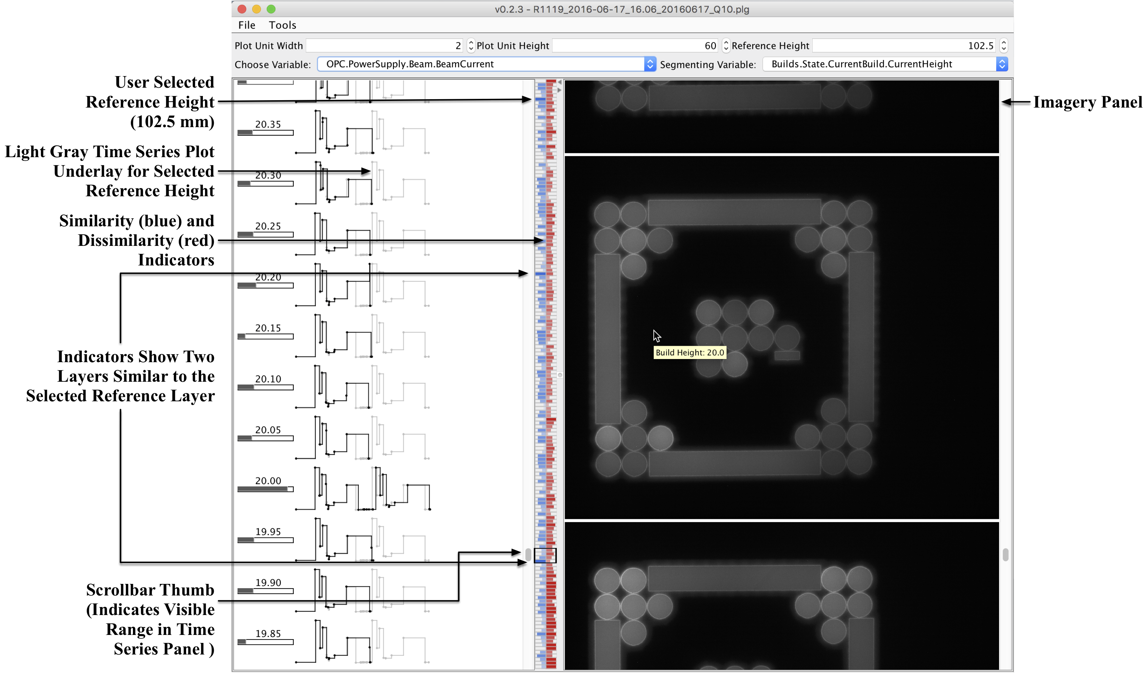
More Detail, on Demand
Notes:
Highest level of detail.
Changes in build height are used to segment full time series into individual layer plots
Selected outlier at the top of the build.
Dynamic time warping metric shows similarities at other locations in the build (other two outliers)
Suggests they may be related
Underlay plot for selected layer lets us compare directly
Slight shift at 20mm layer but appears very similar
At right we can study near IR to look for porosity, hot spots, etc. (appears normal here)
Result from analysis is that the anomalies were caused by arc trips.
Ruled out possibly of a smoke detection event by analyzing smoke detector plot
Further study using high resolution microscopy to study the effects in microstructure.

Slide 26
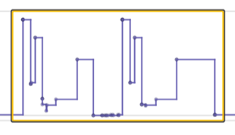
Identifying the Cause of the Outliers
Two possibilities:
Smoke Detector Reset
Arc Trip
Both cause signal repeats
Here, arc trip is the cause
This insight led to additional study to see how arc trips affect the microstructure of a build.
Notes:
We narrowed down the cause of these outliers to either an arc trip or a smoke detection event.
Both conditions are causes for questioning the integrity of the build
When beam is shut off during melting stage, microstructure of layer can be altered
Consistent microstructure is essential for creation production quality parts
Smoke event happens when powder particles are ionized in the vicinity of the electron gun.
Dust cloud can harm the beam filament
Beam shuts off and layer print is restarted, which visually looks like a repeated signal
We rule out a smoke detection event because the plot looks normal
Arc trip occurs when the beam forces too much energy through the filament.
System responds by immediately shutting off the beam and restarting the layer build process
Also looks like a repeated signal in plots
Here the causes are arc trips.
Additional study of the builds will help us see how these scenarios affect the microstructure of the print.

Slide 27
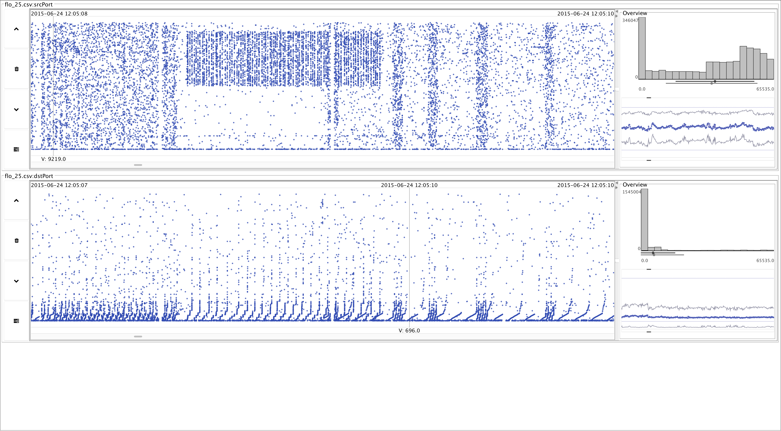
Falcon Applied to Network Flow Analysis

Slide 28
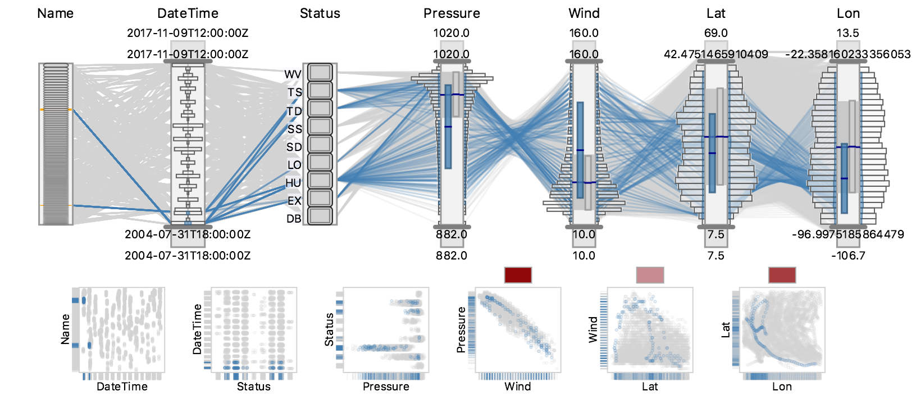
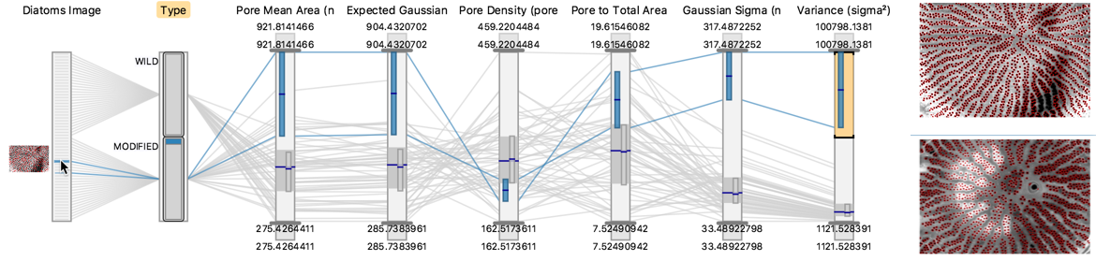
CrossVis: Guided Exploratory Data Analysis
Scientific Achievement
CrossVis enables flexible exploration and comprehensive understanding of large, heterogeneous, and multivariate data by integrating interactive visualizations and statistical analytics.
Significance and Impact
CrossVis helped materials scientists at ORNL CNMS understand and improve a neural network classification process for microscopic imagery with genetic engineering applications.
CrossVis allowed ORNL BER climate scientists to consider more variables from large scale, land model parameter sensitivity analyses and ultimately improve DOE model accuracy.
Research Details
CrossVis implements theoretical information foraging concepts, whereby information dynamically derived from statistical analytics are used to augment interactive data visualizations making key patterns visually salient.
CrossVis provides an advanced multivariate visual analytics framework supporting heterogenous data types (e.g., images, temporal, categorical), progressive high-performance rendering, and a scalable data model.
Design requirements stem from over a decade of experience collaborating with scientists from a variety of domains.
Exploration of Historical Hurricane Observations
Analyze Neural Networks for Microscopic Imagery
CrossVis is a visual analytics tool that integrates statistical analytics and an extended version of parallel coordinates to allow flexible exploratory of large and heterogenous multivariate data. In addition to climate and materials science, CrossVis has been applied to cyber security, manufacturing, power grid, and system performance projects.
Citation: A. Trofimov, … C. Steed. “Deep Data Analytics for Genetic Engineering of Diatoms Linking Genotype to Phenotype via Machine Learning”, npj Computational Materials, 2019.

Slide 29
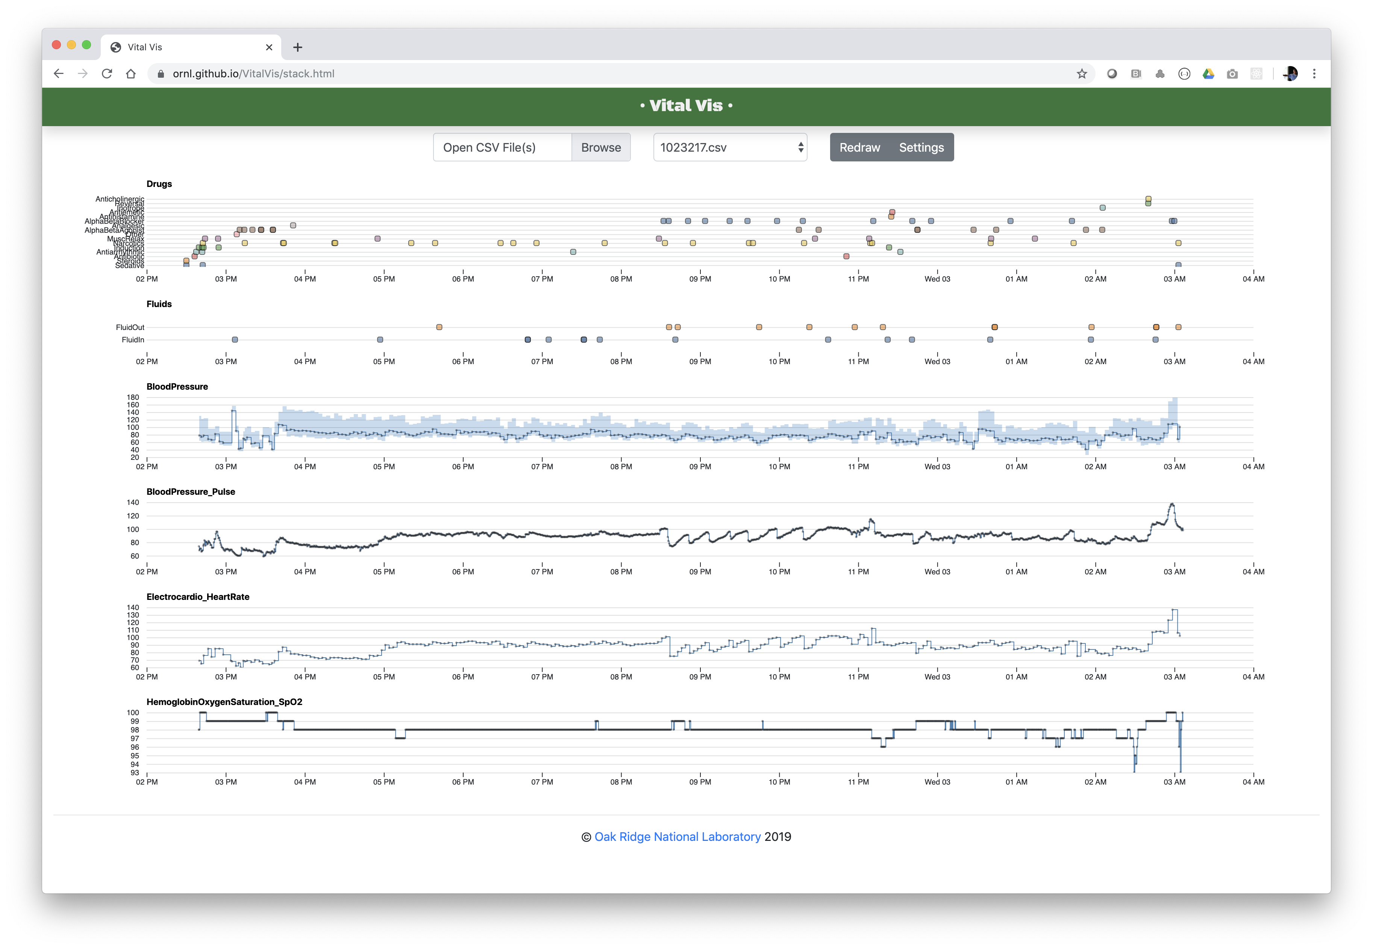
VitalVis: Visual Exploration of Anesthesiology Data

Slide 30
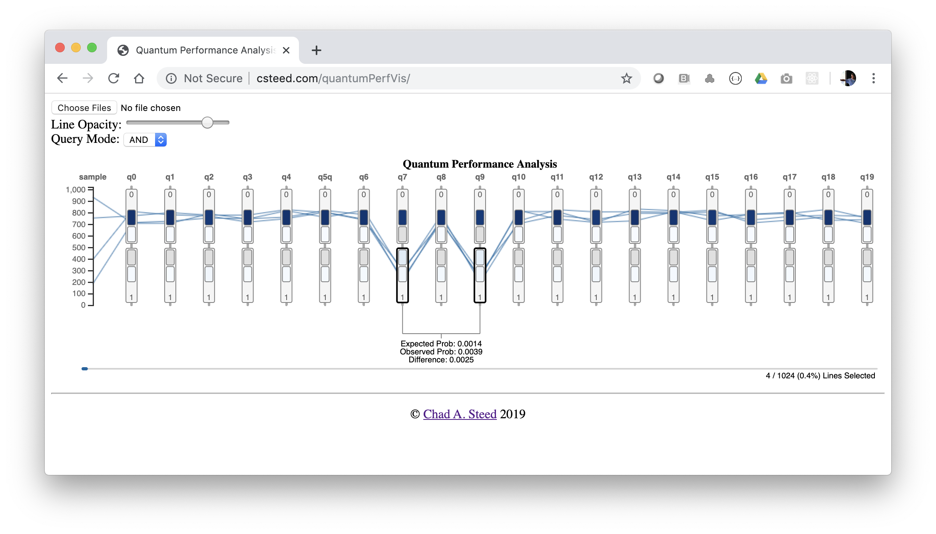
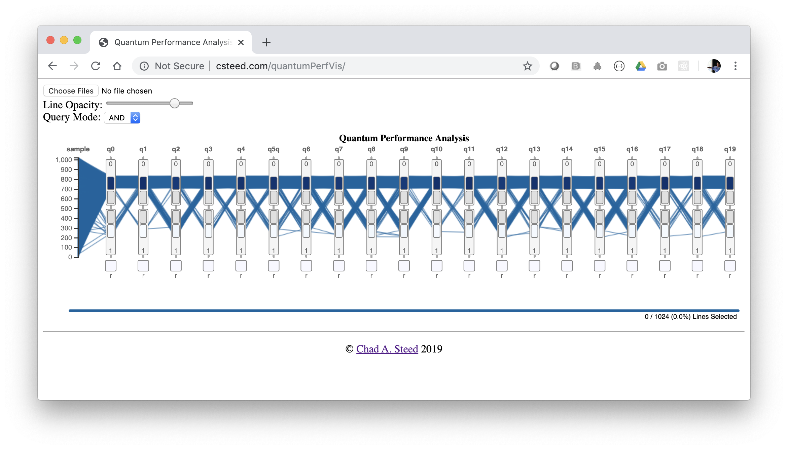
Visual Analysis of Quantum Computing Experiments

Slide 31
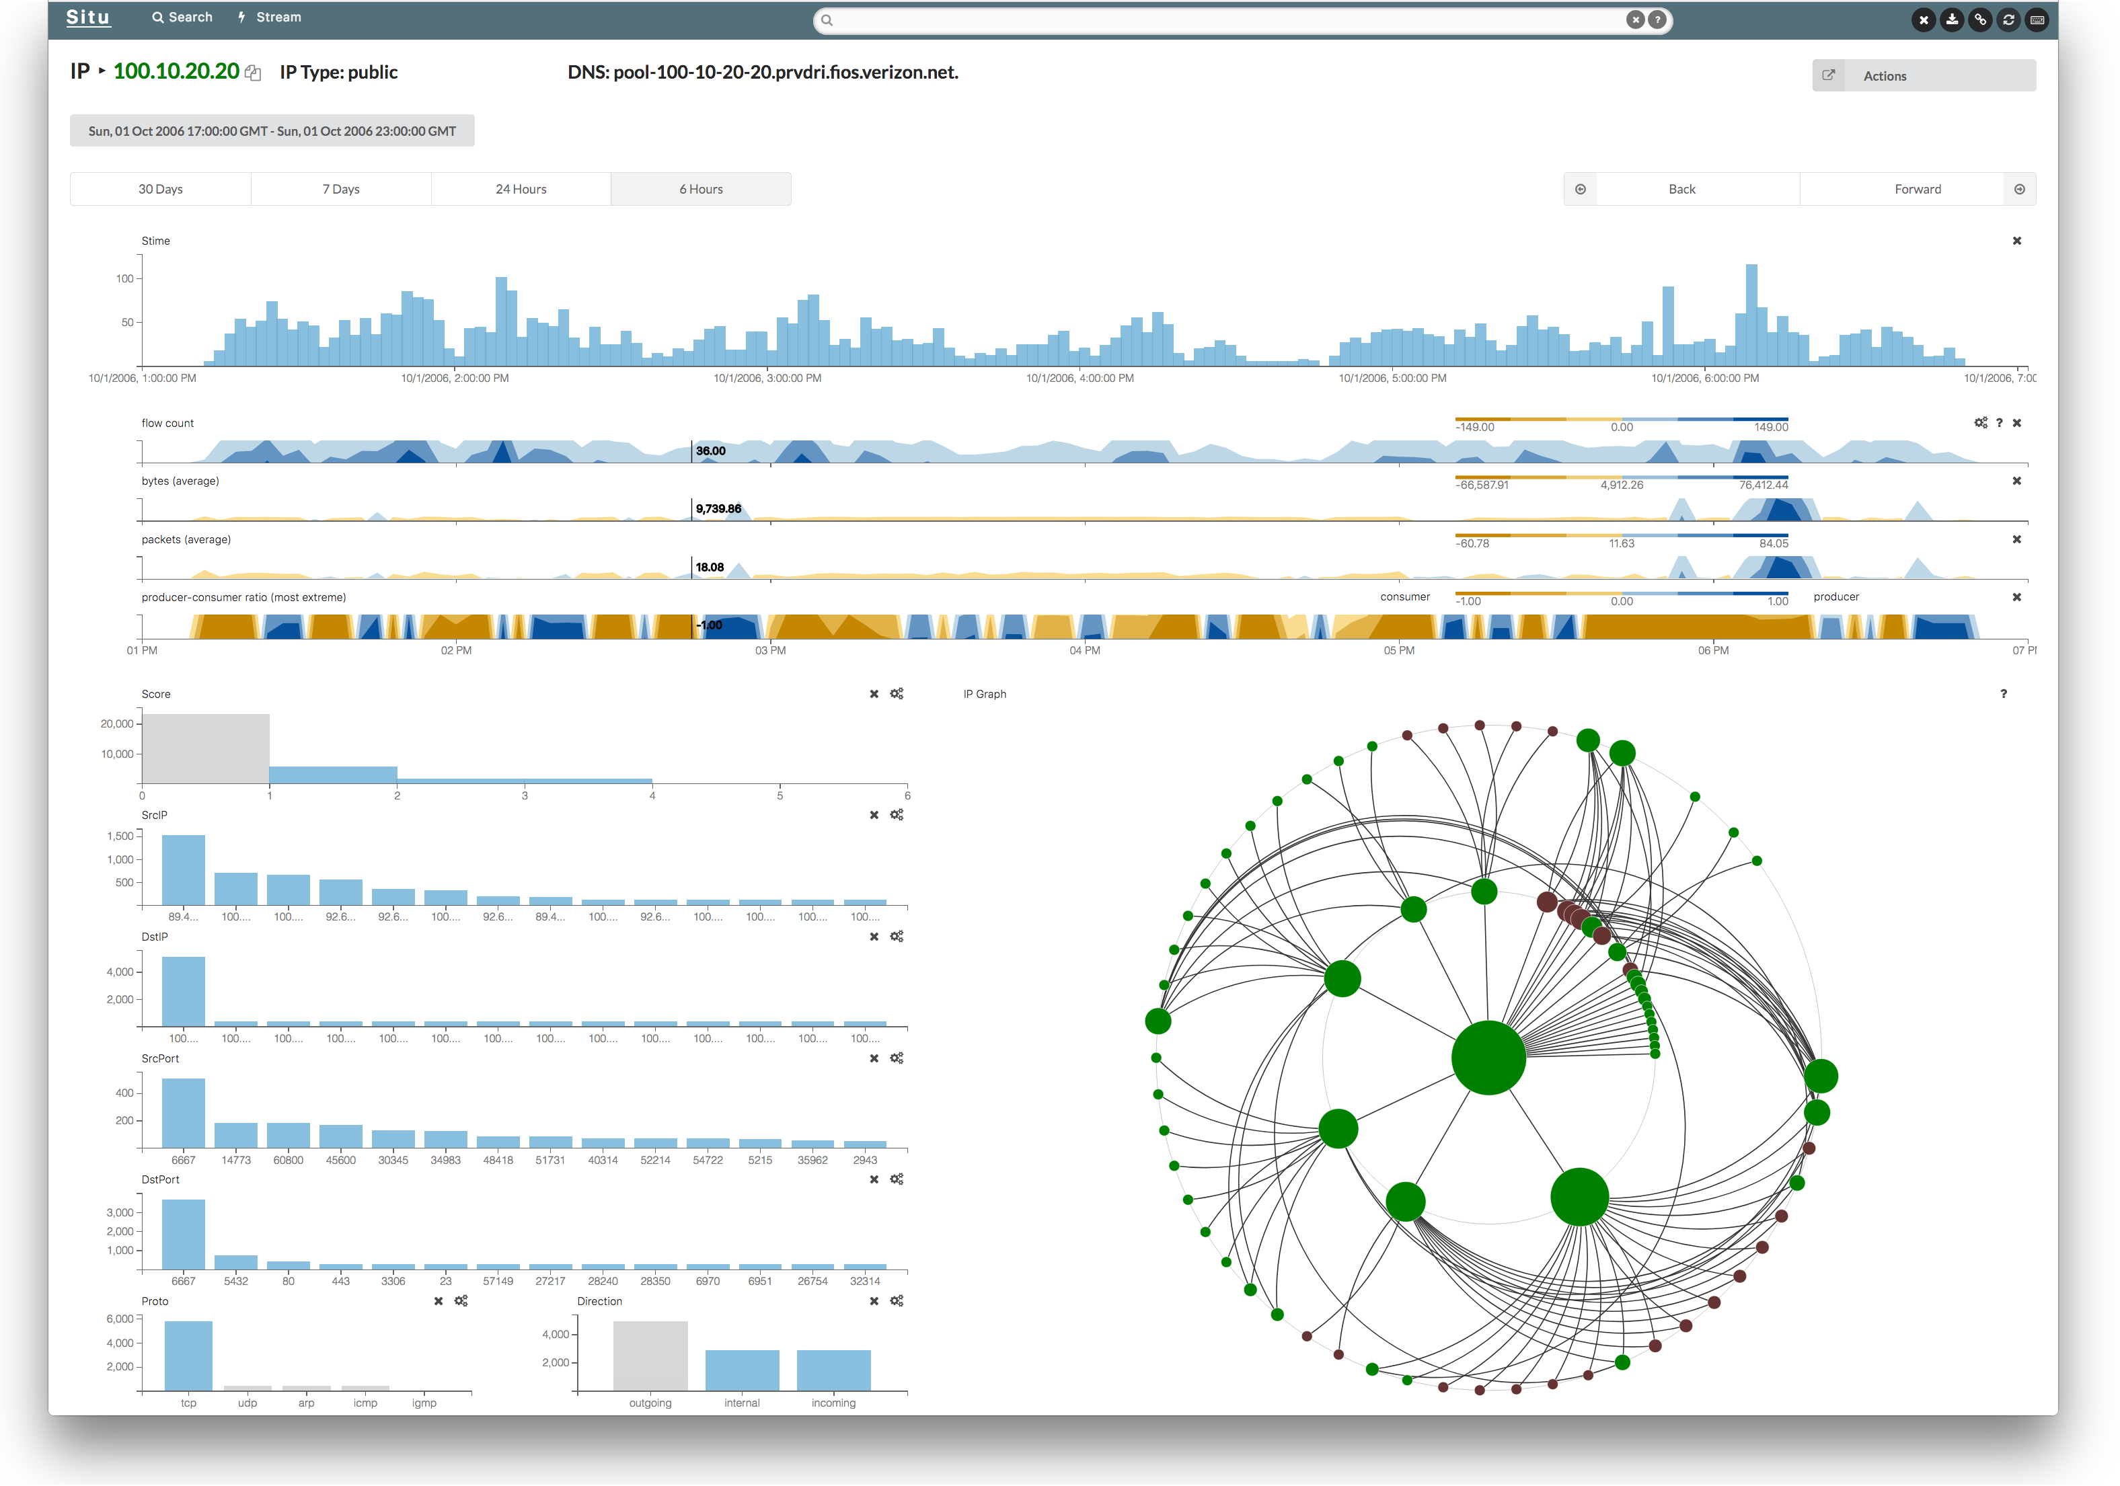
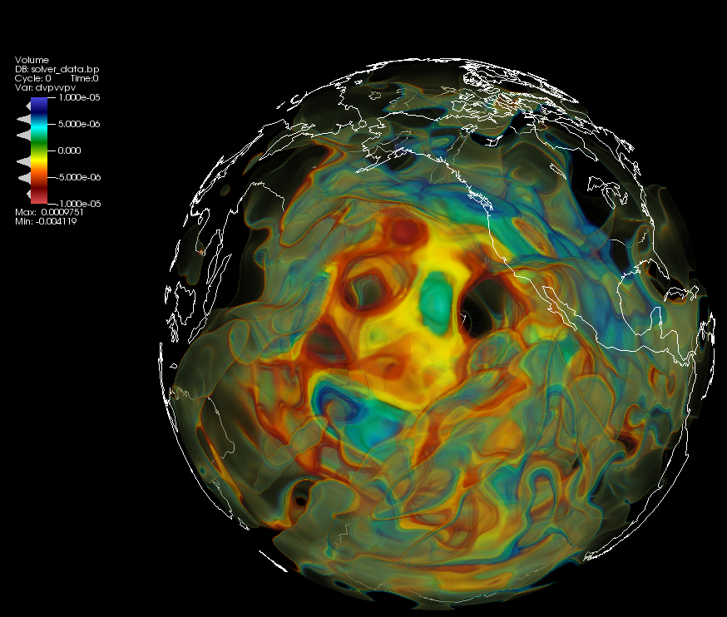
Current State of Data Visualization at ORNL
Data visualization plays an important role in most projects
Teams either recruit visualization help or develop in-house solutions
Success of projects often hinges on delivering effective visualizations
Sometimes data visualization design is delayed until near the end
Significant expertise / resources that are mostly disconnected
Experts across all the data visualization sub-disciplines
Visualization community is missing
Visualization labs are usually not connected
Data visualization capabilities and highlights have low visibility
Tools and techniques developed at ORNL are hard to find
Domain experts have trouble finding data visualization expertise

Slide 32
PROPOSED SOLUTION:
Establish a Hub for Data Visualization at ORNL

Slide 33
ORNL VISTA Lab Mission
Improve domain experts’ ability to explore large and complex data through interactive data visualization and analysis research and development
Build a data visualization community that spans directorates and highlight its work
Form a bridge connecting data visualization expertise to domain-specific data analysis challenges of national significance
Establish an innovative laboratory with interactive displays and software for collaboratively exploring data

Slide 34
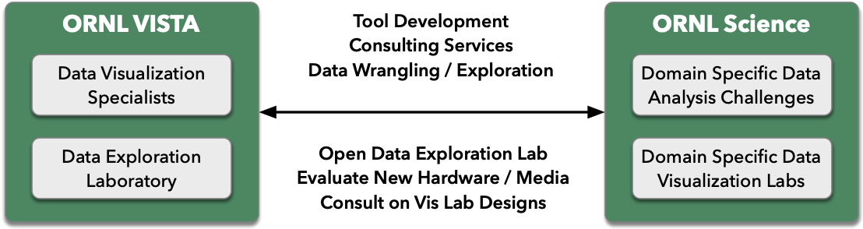
Forming a Bridge Between Visualization and Science
Fulfill the central promise of data visualization by bringing it to bear
in data-rich domains where it’s needed the most.
If successful, this bridge will yield new projects, partnerships, and opportunities.

Slide 35
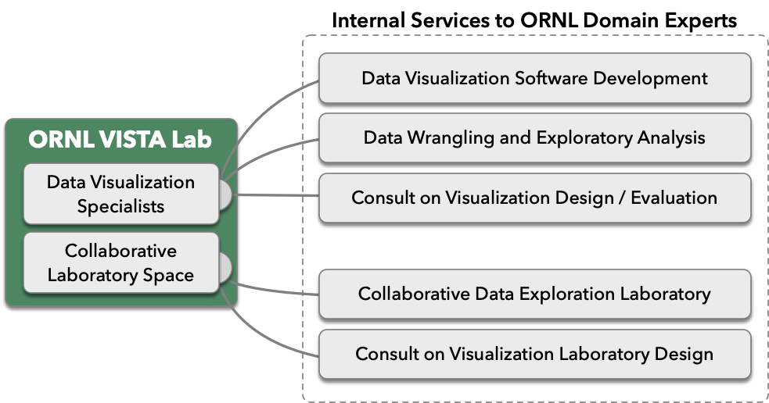
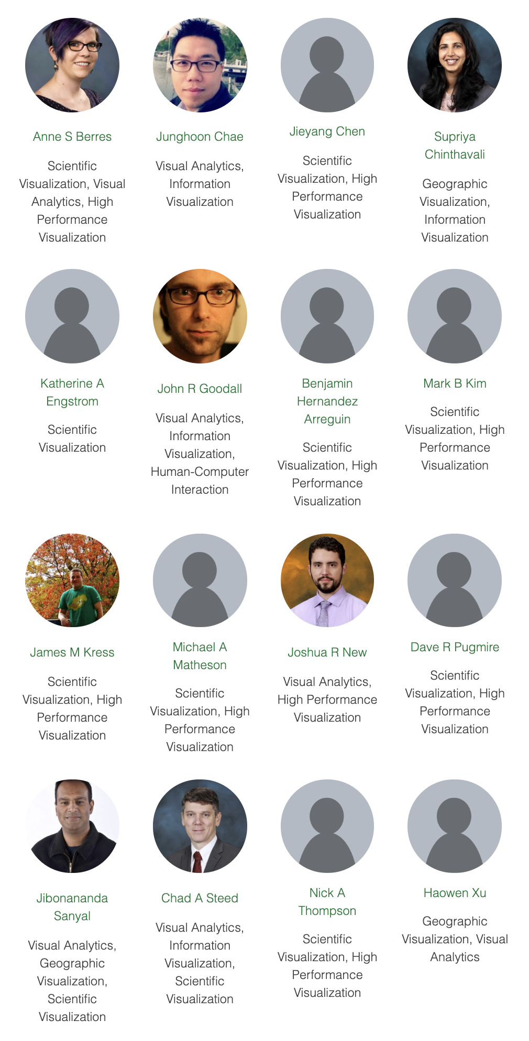
Data Visualization Services for ORNL

Slide 36
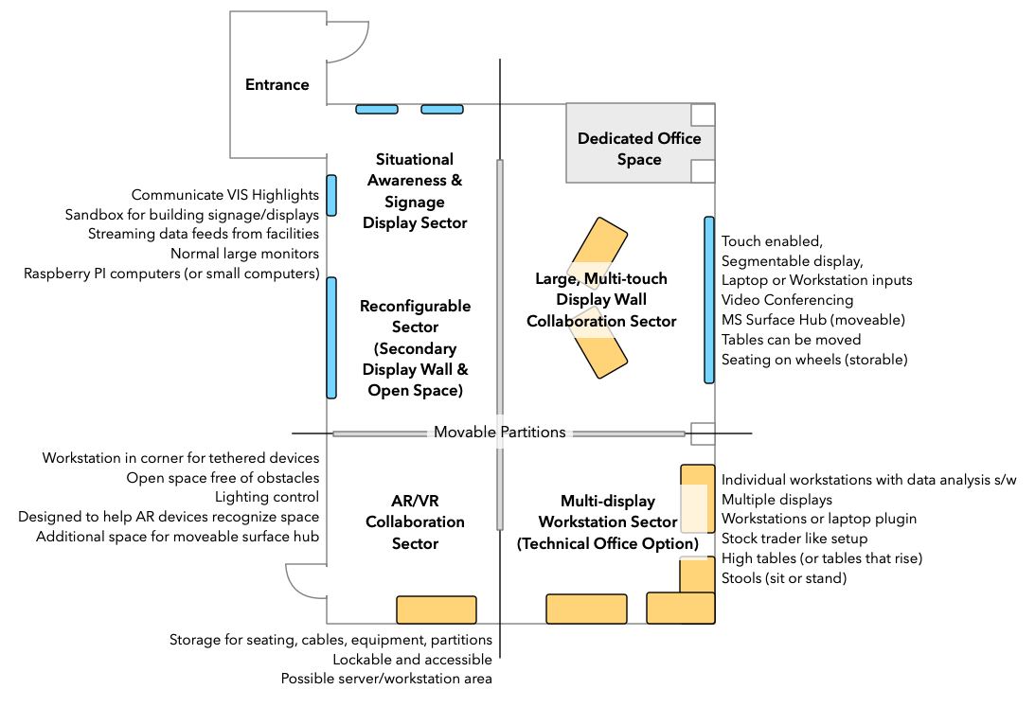
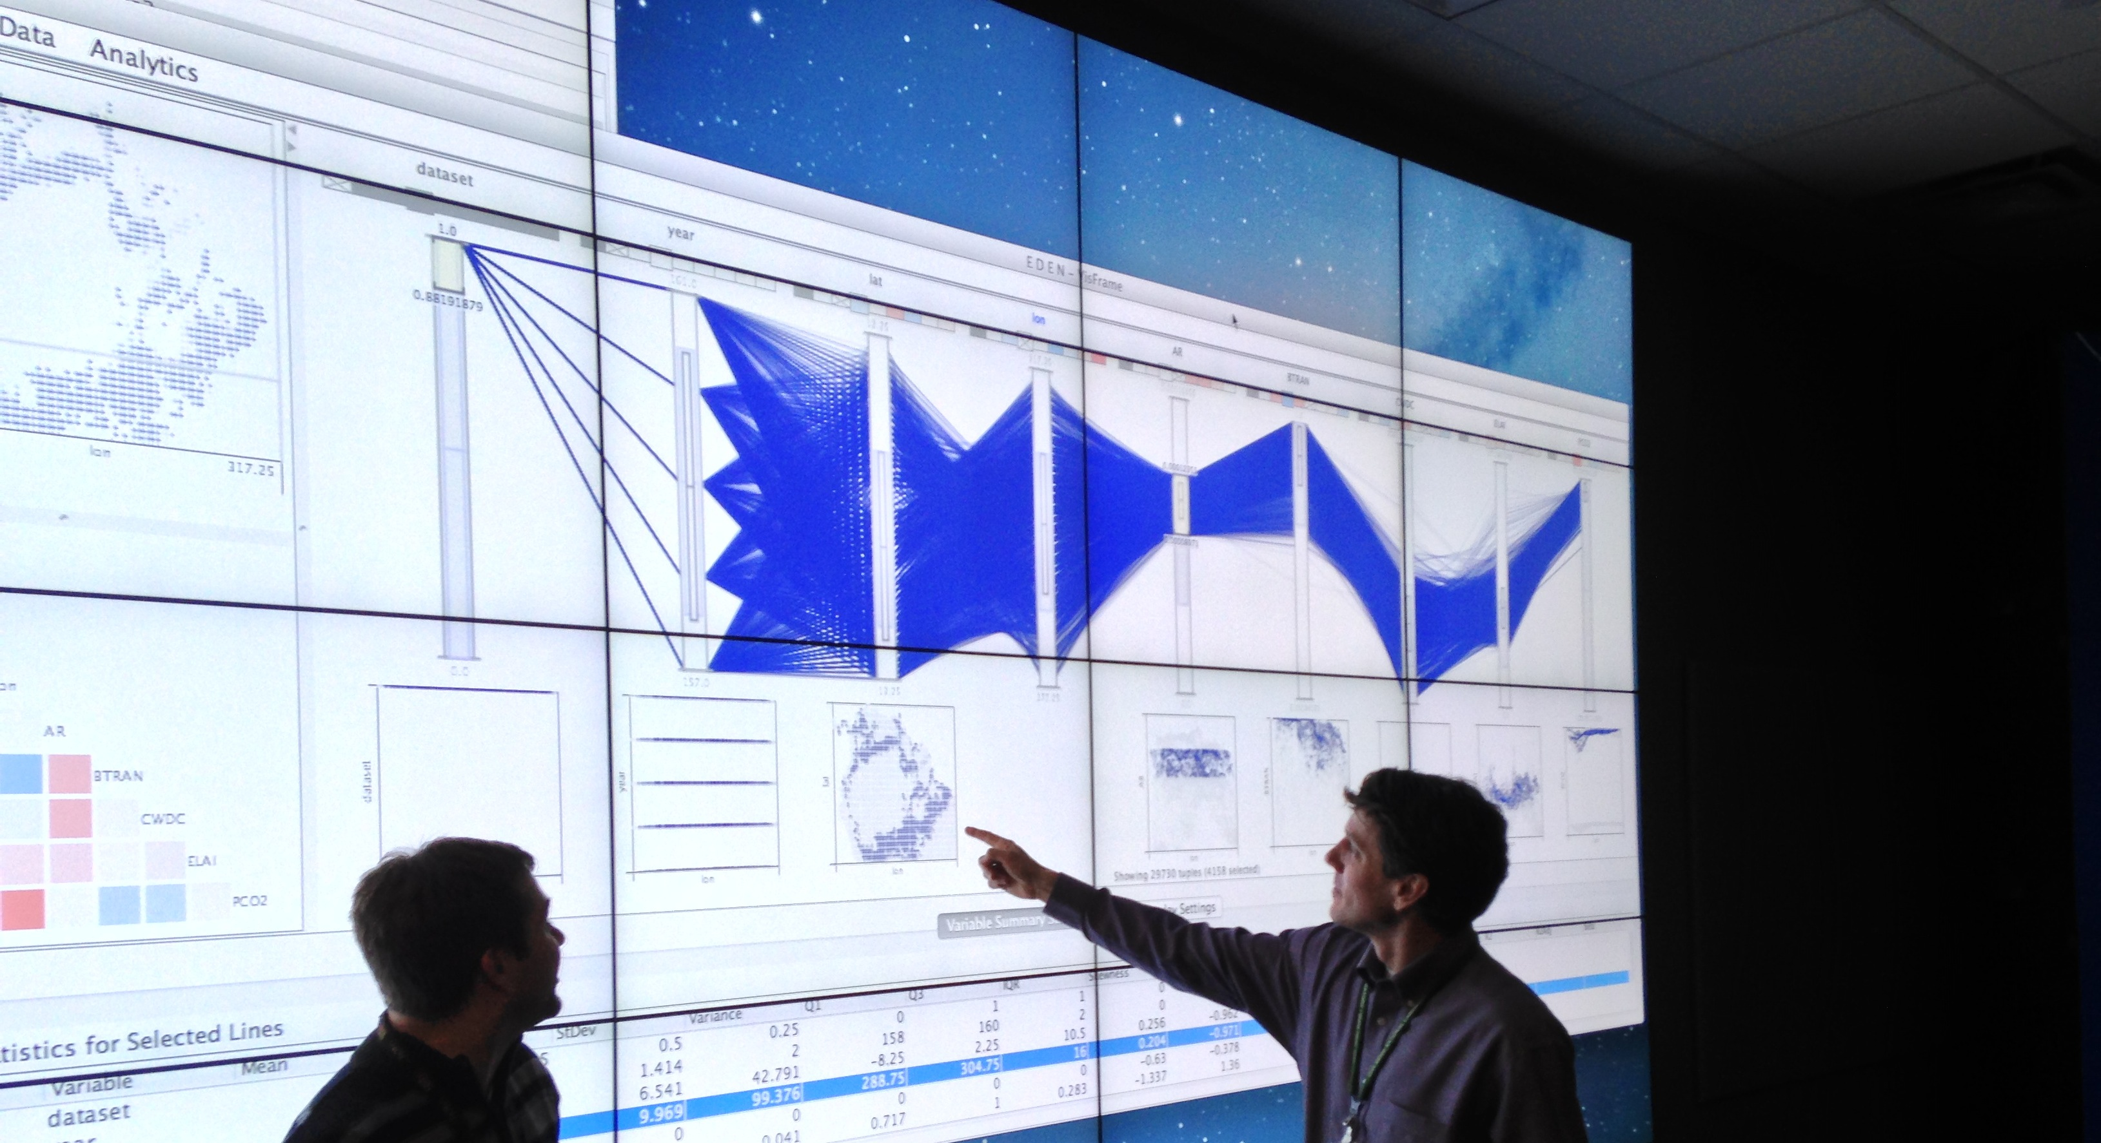
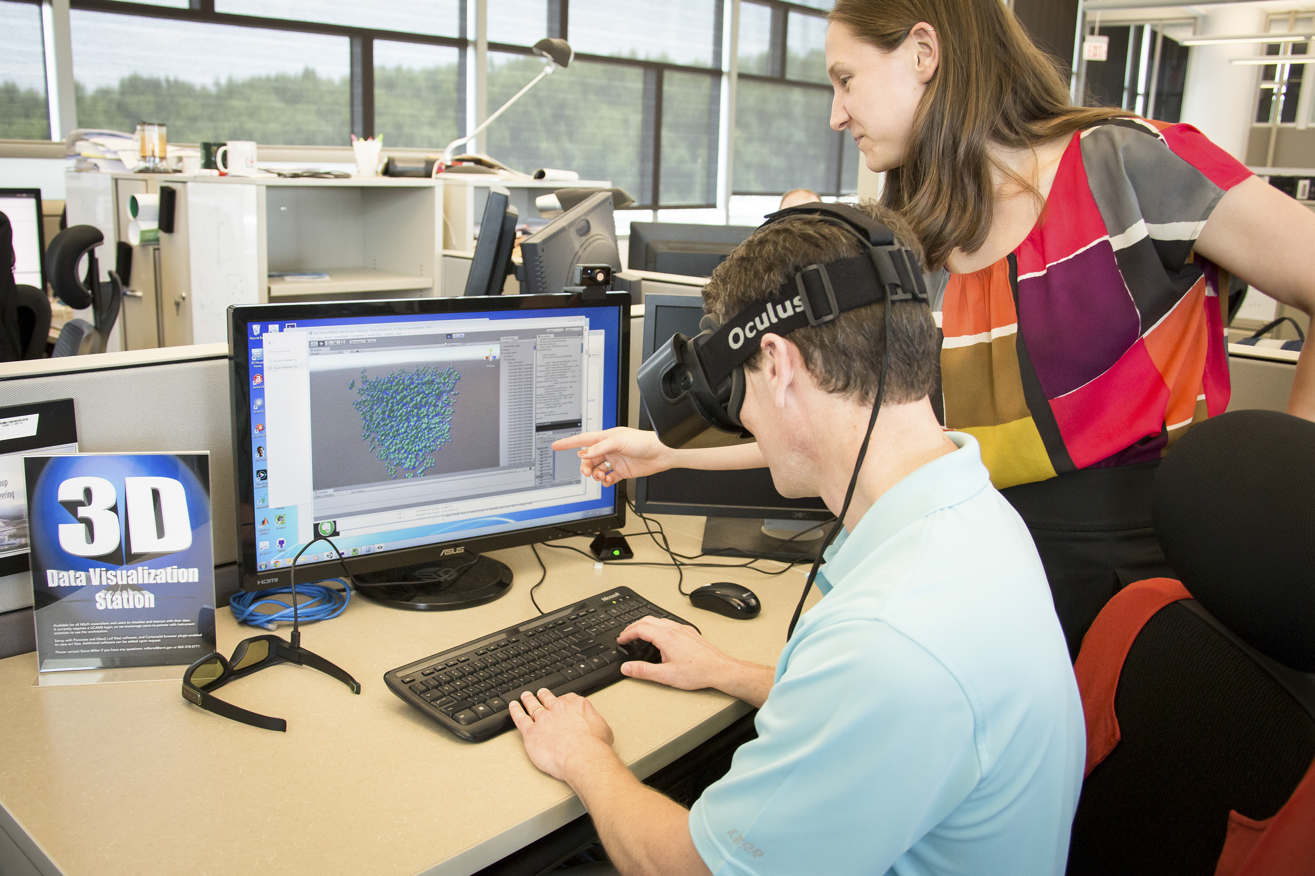
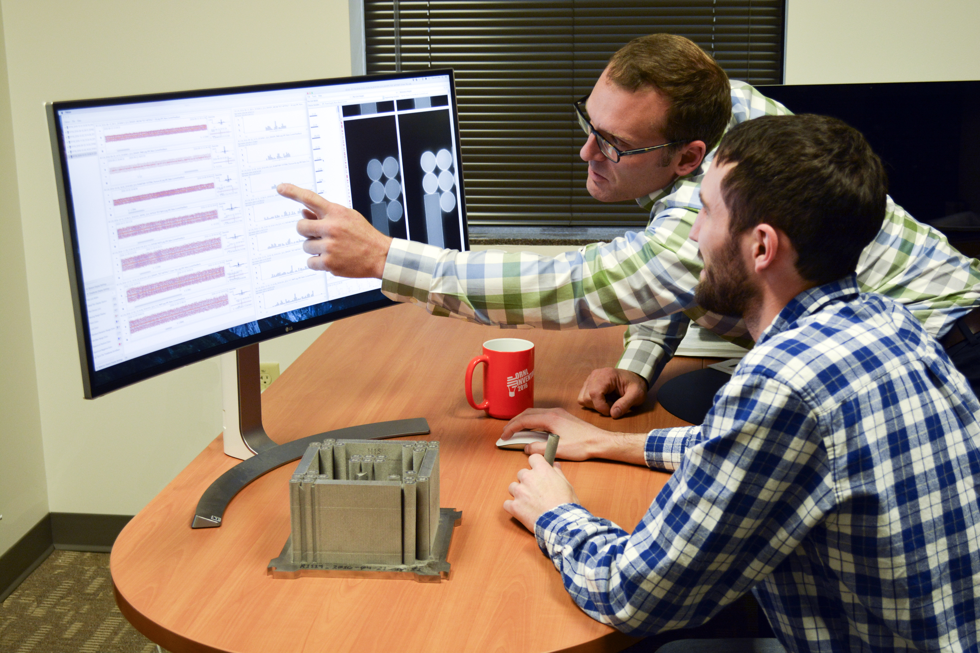
Creating a Collaborative Data Exploration Lab

Slide 37
Other VISTA Lab Activities
Research and Development
Apply existing tools and develop new tools for data exploration
Publications with domain experts
Connect and Expand ORNL Data Visualization Community
Share knowledge and build connections via working groups, hack-a-thons, and data challenges
Organize workshops together; Collaborate on projects; Publications
Promote ORNL Visualization People and Capabilities
Host visitors, recruit, support proposals, and spread the word about specific capabilities
Establish External Partnerships
Academic (faculty and students), industry, and other national laboratories.

Slide 38
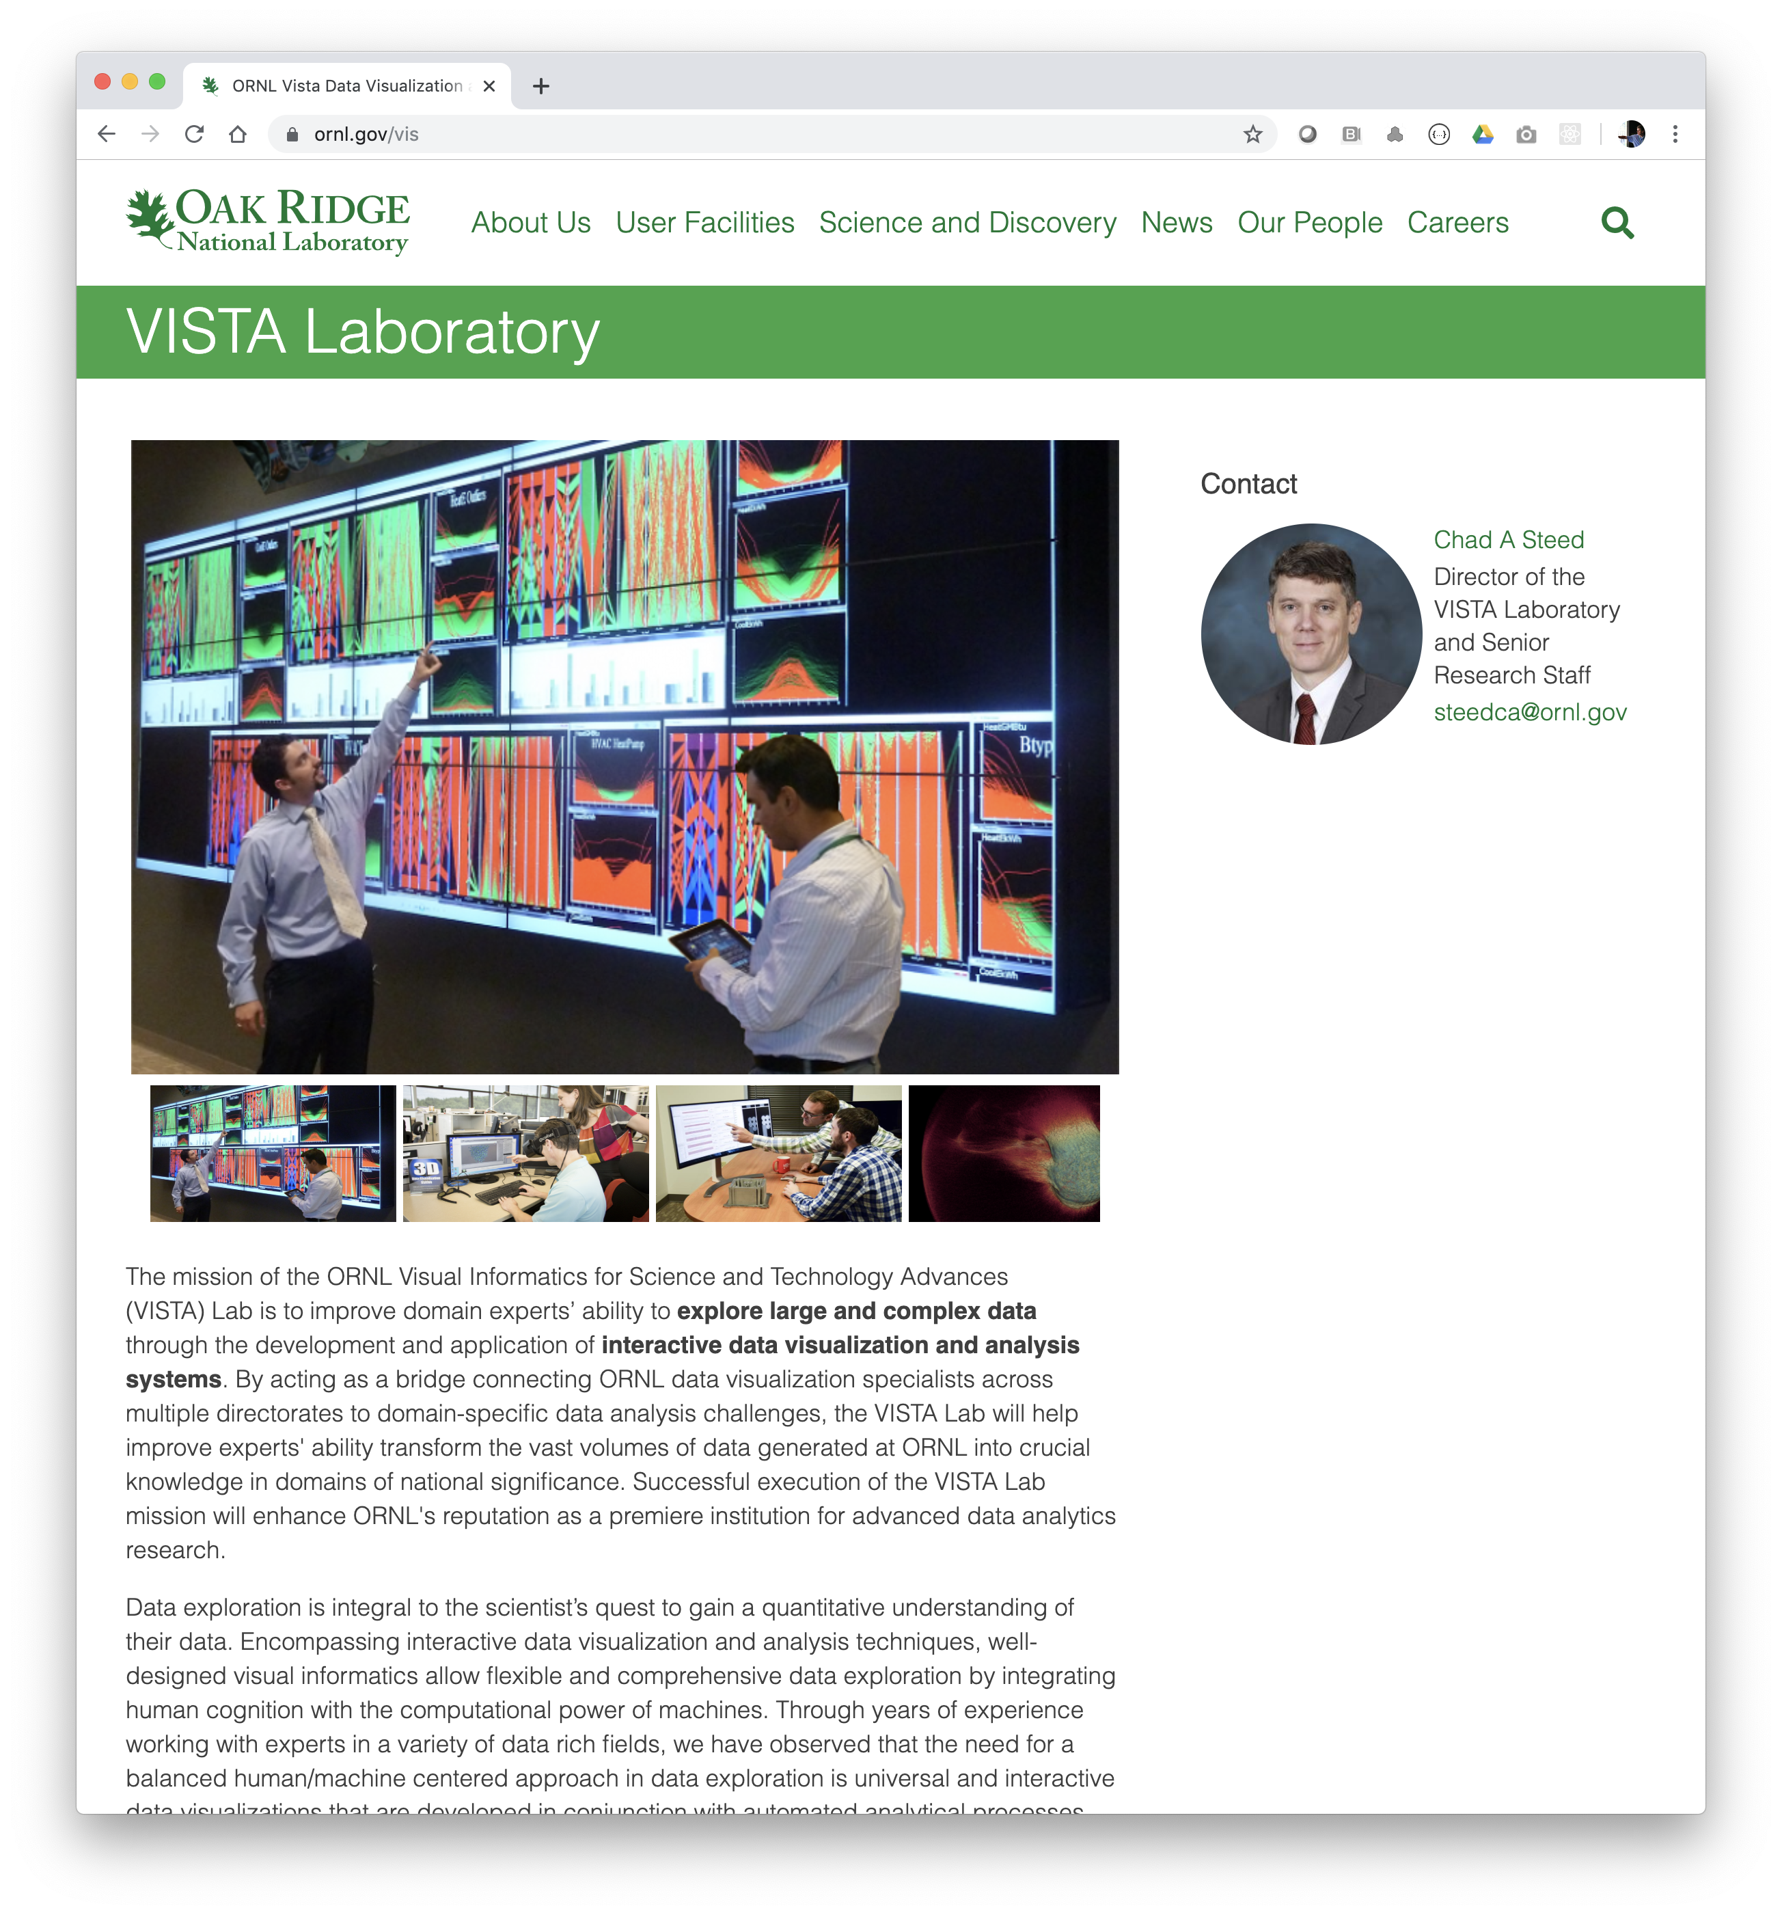
Conclusions
Data Visualization and Visual Analytics expertise is broad and vital to understanding the vast volumes of data at ORNL.
Most domain experts say:
They don’t look at enough of their data
They good at finding what they already know
ORNL is a one-stop-shop for data, use cases, and domain experts
Developing visual analytics tools in close collaboration with domain experts is a rewarding approach
Helps fulfill the central promise of data visualization
VISTA will be the hub for data visualization at ORNL
https://vis.ornl.gov
We are hiring and open to collaborations
https://www.ornl.gov/division/csmd
https://orise.orau.gov/ornl/

Slide 39
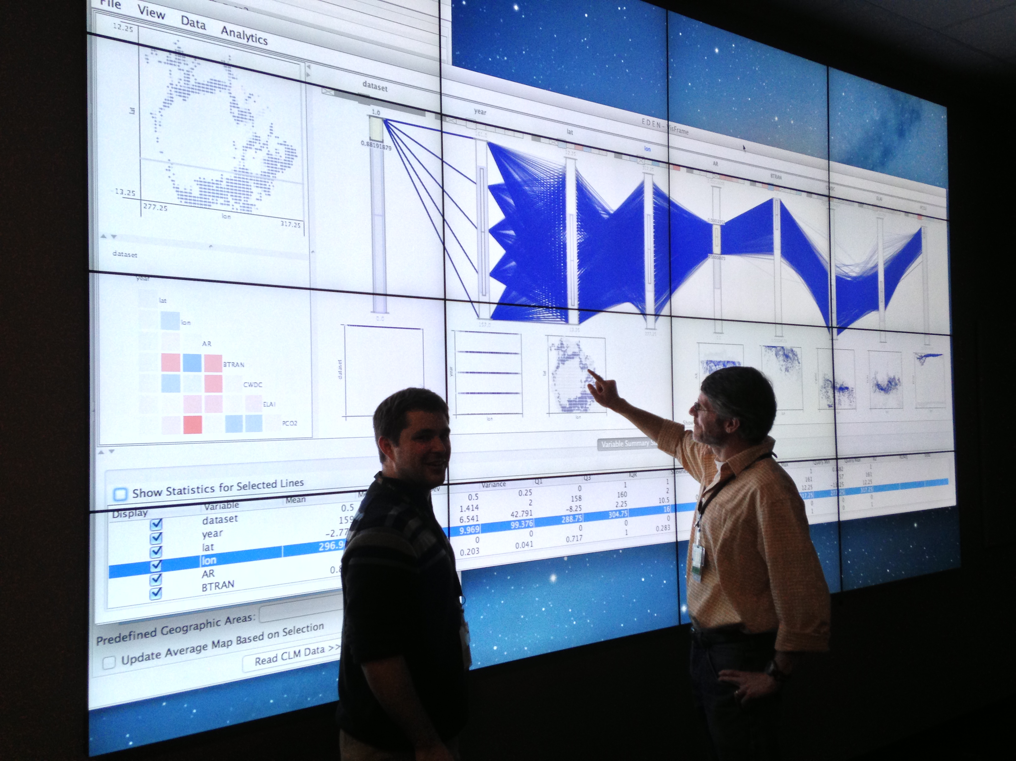
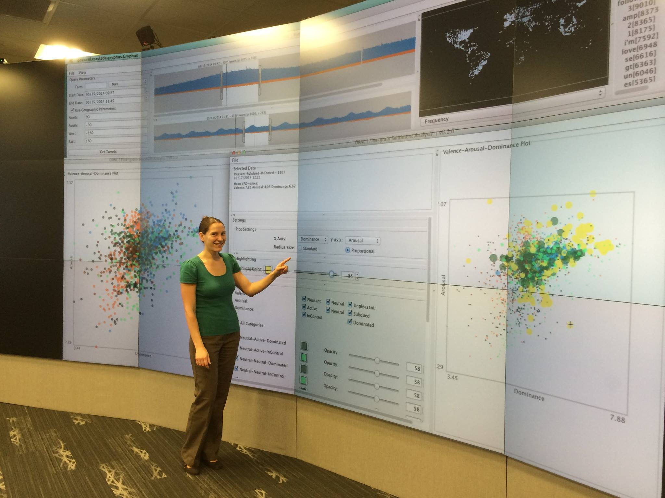
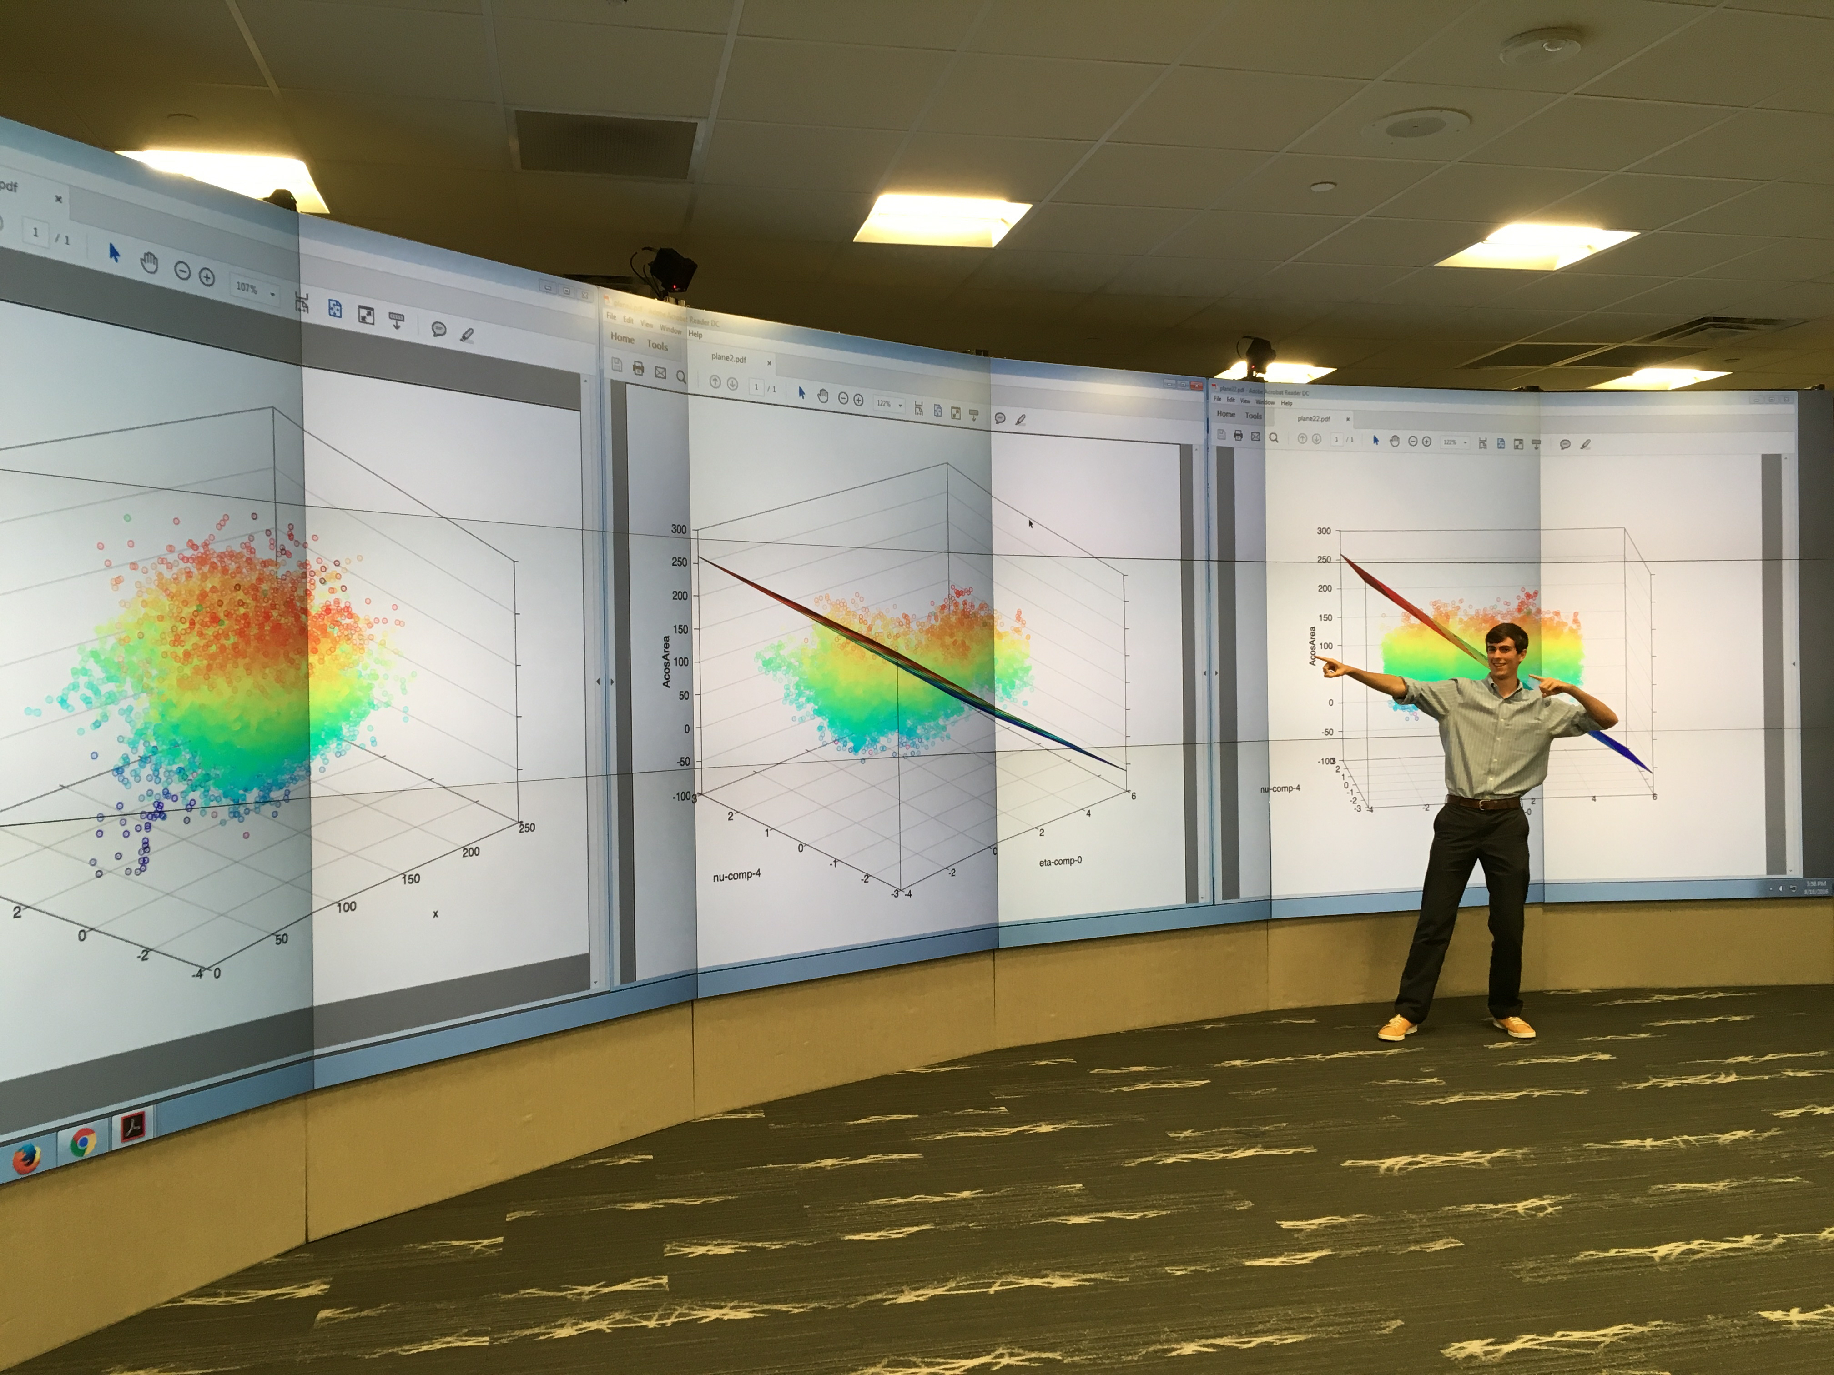
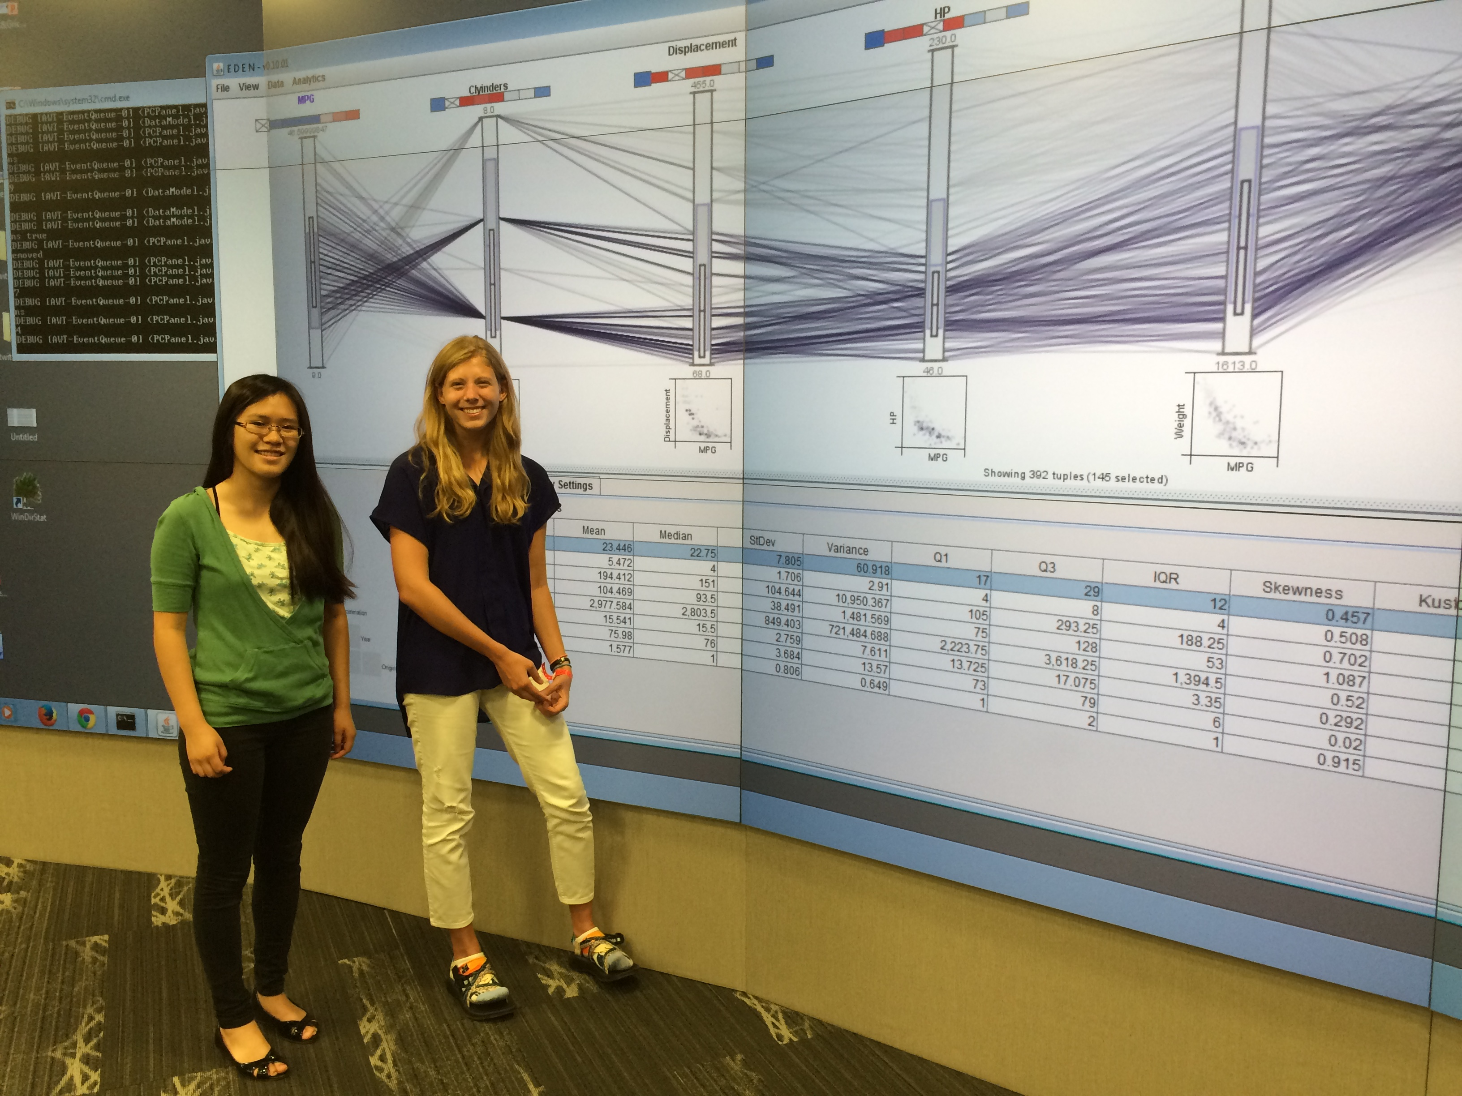
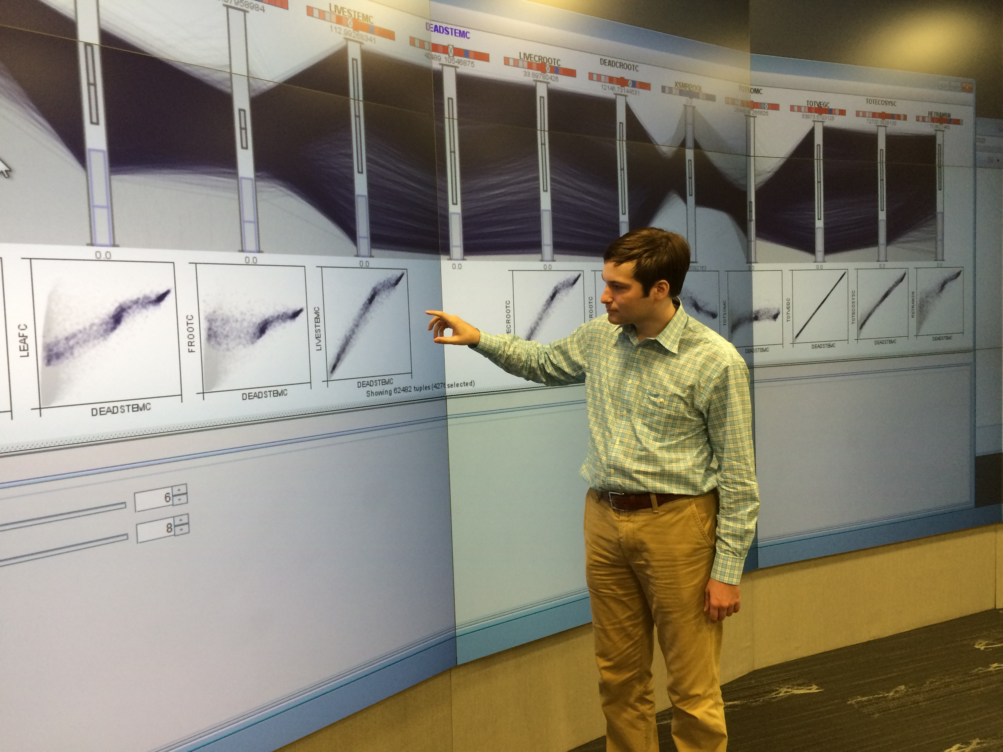
Thank You!

